Slide 1

Heating and cooling solutions
POWERCIAT & Hydrociat

Slide 2

expertise
With over 80 years' experience in climatic engineering, we build our expertise on a close relationship with our customers. Serving different fields, we put our innovative abilities into the design and manufacture of systems that push the boundaries of efficiency and simplicity.
With genuine innovations, we work alongside retail, supermarkets, industries, logistics and cinemas to provide you with optimal engineered solutions.
With hygiene and comfort requirements in mind, we provides global solutions with a low carbon footprint that go beyond the simple notion of kW/h consumed and energy savings.

Slide 3

HIGH EFFICIENCY
Simplicity
We ensure easy installation and integration with building management systems.
High air quality
We are committed to the research and development of innovative solutions aimed at improving indoor air quality. By integrating ventilation, quality sensors, airflow control and increased filter efficiency into our equipment, CIAT goes even further to eliminate pollution and contamination.
Energy optimization
We develop energy efficient solutions allowing substantial savings to be made without compromising our product’s efficiency.

Slide 4

Guiding you right from the start
To ensure you are provided with the right solutions, CIAT Experts will work alongside you from conception and throughout the implementation of your project.
They will analyze your specifications, and thanks to their expertise and specific software designed by our engineers, will provide you with the optimum solution to meet your requirements.

Slide 5

Your challenges
ENERGY OPTIMIZATION
High seasonal energy efficiency
Compliance with Ecodesign 2021 requirements
Energy savings
Advanced system control

Slide 6
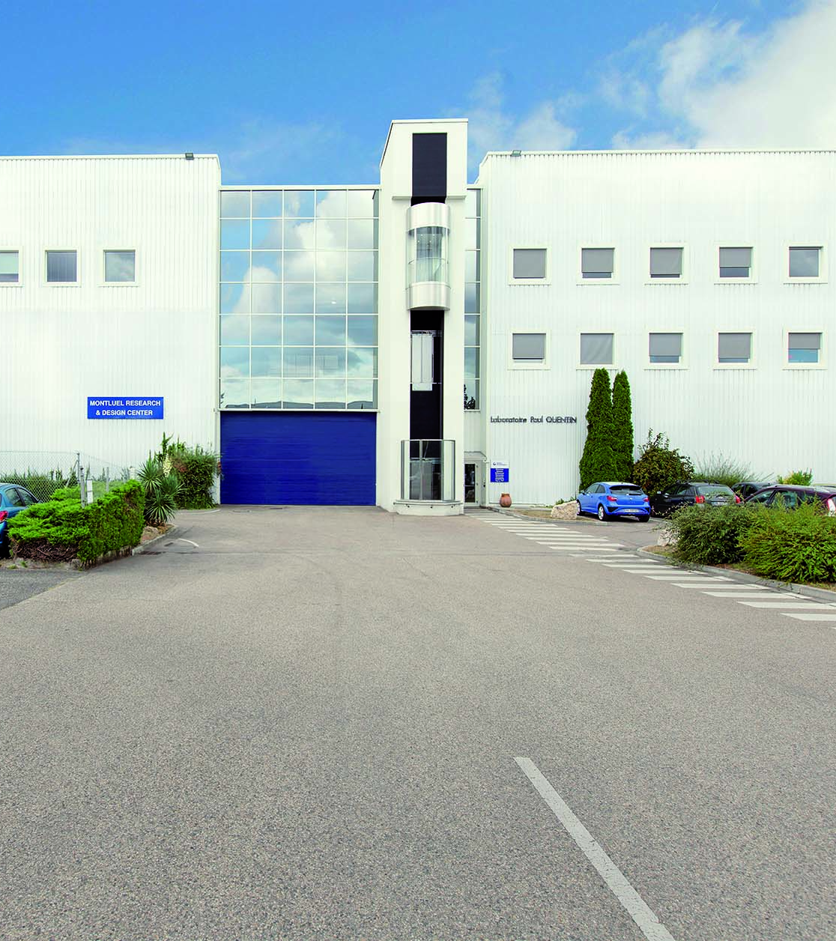
Montluel Center
OF EXCELLENCE:
AT THE FOREFRONT OF CHILLER AND HEAT PUMP TECHNOLOGIES
Montluel’s experts bring their specialist knowledge and engineering skills. Their aim is to offer our customers the best in chiller and heat pump innovation.
Customisation
The research and design center and laboratory has a dedicated customization team specializing in bespoke solutions to meet the chiller and heat pump needs of individual customers.
Prototypes & Tests
The Montluel Center of Excellence carries out prototyping for internal development teams and testing for both internal teams and customers.

Slide 7

PowerCIAT & HydrociaT
energy efficient and flexible HEATING AND COOLING SOLUTIONS

Slide 8
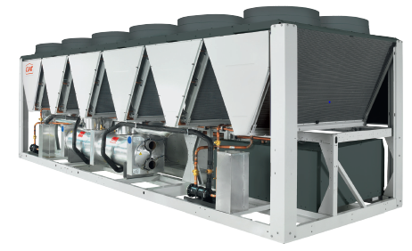
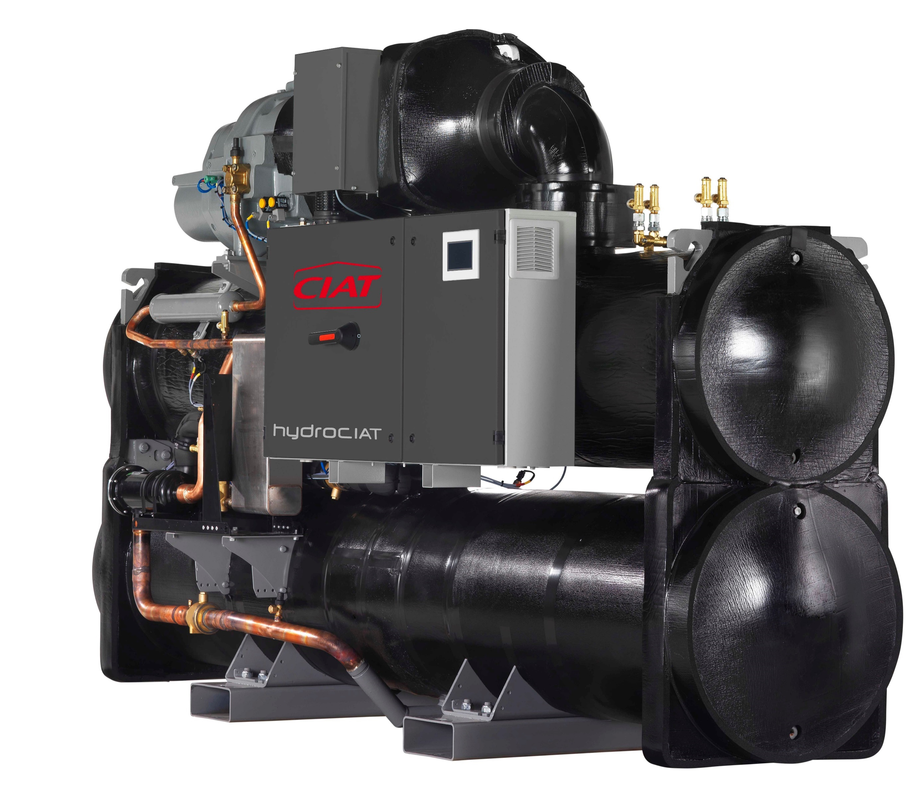
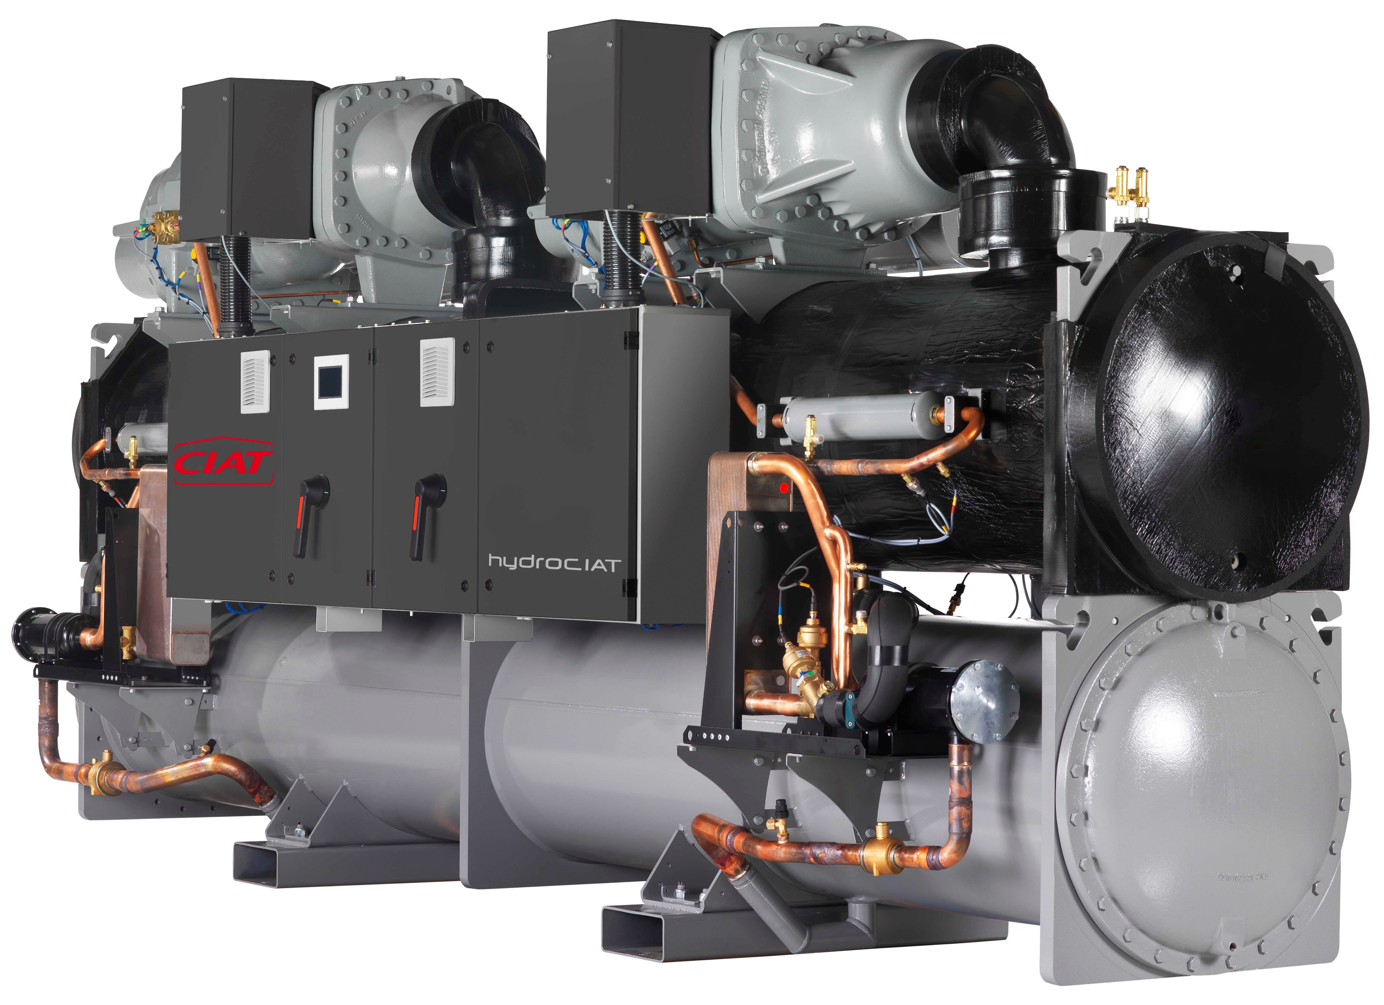


POWERCIAT
HYDROCIAT
      The Powerciat air-cooled screw chiller range complies with the latest Ecodesign regulations, addressing environmental concerns and offering increased performance to better meet customer needs. Choose between the Powerciat Standard, High-Efficiency and Premium versions and four acoustic levels for noise-sensitive applications.
      The Hydrociat water-cooled screw chiller range is designed to meet a broad range of heating and cooling requirements, while ensuring easy installation and commissioning, and offering excellent energy efficiency.
10/07/2023
- Hydrociat & Powerciat – customer presentation

Slide 9
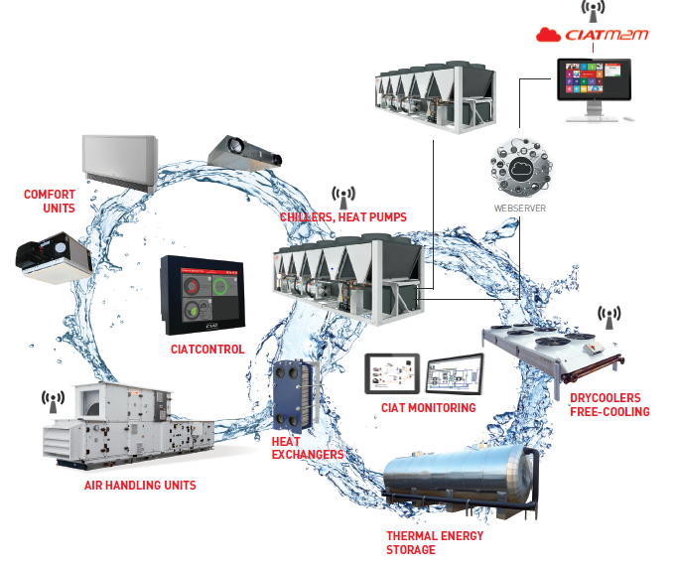


GLOBAL SYSTEM PROVIDER
10/07/2023
- Hydrociat & Powerciat – customer presentation

Slide 10
PowerCIAT
ENERGY EFFICIENT MULTI-PURPOSE COOLING

Slide 11






POWERCIAT
ENERGY EFFICIENT
MULTI-PURPOSE COOLING
High energy efficiency
ENERGY SAVINGS
Acoustic comfort
Simplicity & connectivity
Advanced system control
10/07/2023
- Hydrociat & Powerciat – customer presentation

Slide 12

POWERCIAT
High energy efficiency
  We strive to conform to your highest environmental commitments. Starting in January 2021, new energy efficiency requirements will come into effect with the latest European Ecodesign regulations for chillers. We have concentrated our efforts on making our units more efficient and environmentally responsible to comply with these new regulations.
High-efficiency version (HE)
Premium version (XE)
SEER
up to 4,62
SEER
up to 4,77
10/07/2023
- Hydrociat & Powerciat– customer presentation

Slide 13
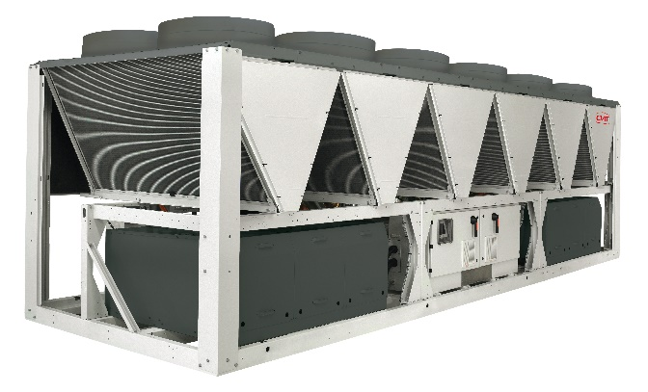
POWERCIAT
Energy savings
We develop energy-efficient solutions that provide substantial savings. Powerciat units have been designed to reduce energy consumption with advanced features: variable ventilation, free-cooling, low-pressure drop filters and energy recovery systems. The heat recovery feature can even provide hot water up to 65°C.
Up to 30%
energy savings*
10/07/2023
- Hydrociat & Powerciat – customer presentation
*with energy recovery options

Slide 14



POWERCIAT
Acoustic comfort
We guarantee low noise levels during operation thanks to design optimization and the latest technology to meet the most stringent requirements.
LOW NOISE
-4 to -6dB(A)*
Thanks to the compressor enclosure
XTRA LOW NOISE
-7 to -10 dB(A)*
Thanks to the compressor enclosure and low-speed fans
SUPER LOW NOISE
-9 to -12 dB(A)*
Thanks to the compressor enclosure and low-speed fans as well as enhanced sound insulation for the main sources of noise
10/07/2023
- Hydrociat & Powerciat – customer presentation
*compared with standard unit

Slide 15
POWERCIAT
SIMPLICITY
We provide an all-in-one solution thanks to the integrated hydraulic module which contains all the water circuit components needed for the system to operate correctly.
Hydraulic modules are available from sizes 270 to 400 kW and can be equipped with a large choice of pumps:
Single or twin pumps.
Fixed speed high / low-pressure pumps.
10/07/2023
- Hydrociat & Powerciat – customer presentation

Slide 16
POWERCIAT
ADVANCED SYSTEM CONTROL
We optimize energy consumption while ensuring optimal occupant comfort using a set of interconnected services that simultaneously monitor all energy and water loop components.
CONECT TOUCH
Power control
Abound HVAC Perfomance
CRISTO control
10/07/2023
- Hydrociat & Powerciat – customer presentation

Slide 17
A COMBINATION OF TECHNOLOGIES

Slide 18

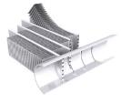


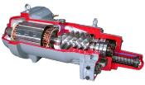
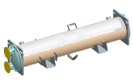
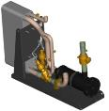
A COMBINATION OF TECHNOLOGIES
Variable speed fans
AC motor + drive (HE version)
EC motor (XE version)
Micro-channel
condenser coil
Connect Touch
control
Screw compressor
Flooded shell & tubes
evaporator
Economiser
10/07/2023
- Hydrociat & Powerciat – customer presentation

Slide 19
MAXIMUM EFFICIENCY

Slide 20
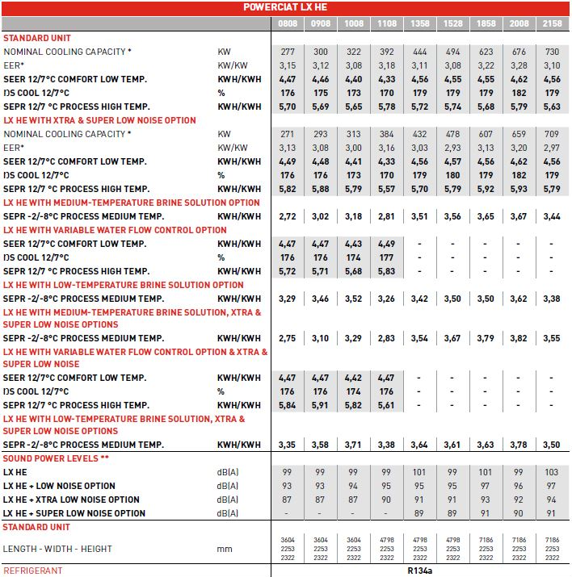

MAXIMUM EFFICIENCY
(1) In accordance with EN 14511-2013 EUROVENT Chilled water = 12°C/7°C Outside air = 35°C
Pf = Cooling capacity
EER = Full load performance coefficient
SEER12/7-SEPR12/7 = Seasonal performance coefficient in accordance with applicable Ecodesign regulation (EU) No 2016/2281
10/07/2023

Slide 21
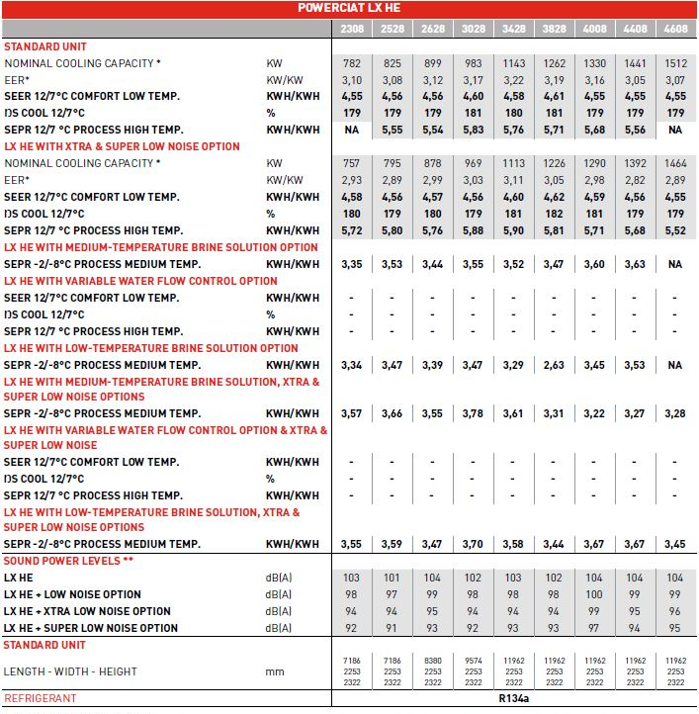
MAXIMUM EFFICIENCY
(1) In accordance with EN 14511-2013 EUROVENT Chilled water = 12°C/7°C Outside air = 35°C
Pf = Cooling capacity
EER = Full load performance coefficient
SEER12/7-SEPR12/7 = Seasonal performance coefficient in accordance with applicable Ecodesign regulation (EU) No 2016/2281
10/07/2023

Slide 22

MAXIMUM EFFICIENCY
(1) In accordance with EN 14511-2013 EUROVENT Chilled water = 12°C/7°C Outside air = 35°C
Pf = Cooling capacity
EER = Full load performance coefficient
SEER12/7-SEPR12/7 = Seasonal performance coefficient in accordance with applicable Ecodesign regulation (EU) No 2016/2281
10/07/2023

Slide 23
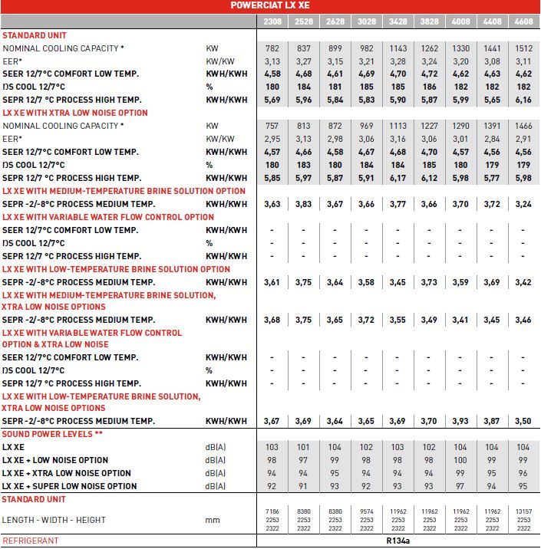
MAXIMUM EFFICIENCY
(1) In accordance with EN 14511-2013 EUROVENT Chilled water = 12°C/7°C Outside air = 35°C
Pf = Cooling capacity
EER = Full load performance coefficient
SEER12/7-SEPR12/7 = Seasonal performance coefficient in accordance with applicable Ecodesign regulation (EU) No 2016/2281
10/07/2023

Slide 24
FEATURES AVAILABILITY
POWERCIAT
Medium-temperature brine solution |  | Total heat recovery | 808-3028 | LP single-pump hydraulic module | 808 -1108
Low-temperature brine solution |  | Evaporator with one pass less | 808-3028 | LP dual-pump hydraulic module | 808 -1108
Light-brine solution, down to -3°C |  | Master/slave operation |  | Dual relief valves on 3-way valve | 808 -3028
Unit equipped for air discharge ducting |  | 21 bar evaporator |  | Compliance with Swiss regulations | 
Low noise |  | Single power connection point | 3428-4608 | Compliance with Russian regulations | 
Xtra Low Noise |  | Evap. and pumps with aluminum jacket | 0808-1108 | Bacnet over IP | 
Super Low Noise | 1308-4608 | Reversed evaporator water connections |  | Energy Management Module | 
IP54 control box |  | Service valve set |  | 7" user interface | 
Tropicalisation of the electric box |  | Evaporator with one pass more |  | Input contact for Refrigerant leak detection | 
Proctection grilles |  | Set point adjustment by 4-20mA signal |  | Compliance with Australian regulations | 
230 V electrical plug |  | Lon gateway |  | Insulation of the evap. in/out ref.lines | 
Water exchanger frost protection |  | HP single-pump hydraulic module | 808 -1108 | MCHE anti-corrosion protection Protect2 | 
Evaporator & hydraulic module frost protection | 808 - 1108 | HP dual-pump hydraulic module | 808 -1108 | MCHE anti-corosionprotection Protect4 | 
Evaporator with aluminum jacket |  | Expansion tank | 808 - 1108 | Anti-vibration mounts | 
Free cooling drycooler management |  | Variable Water Flow control | 808 - 1108
Supplied as standard | 

Slide 25
HydroCIAT
HIGH EFFICIENCY IN A FLEXIBLE AND COMPACT SOLUTION

Slide 26

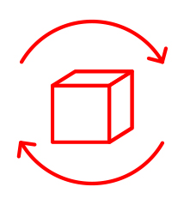
HYDROCIAT
HIGH EFFICIENCY
IN A FLEXIBLE
AND COMPACT SOLUTION
High energy efficiency
Plug and play compact system
FLEXIBILITY
Advanced system control
10/07/2023
- Hydrociat & Powerciat – customer presentation

Slide 27
HYDROCIAT
High energy efficiency
  We strive to conform to your highest environmental commitments.Starting in January 2021, new energy efficiency requirements will come into effect with the latest European Ecodesign regulations for chillers. We have concentrated our efforts on making our units more efficient and environmentally responsible to comply with these new regulations.
Standard version
Premium version
SEER
up to 7,69
SEER
up to 7,86
10/07/2023
- Hydrociat & Powerciat – customer presentation

Slide 28
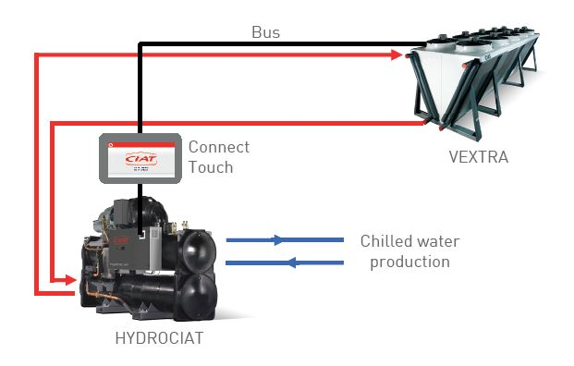
HYDROCIAT
Plug & play compact system
  We design the most compact water-to-water chillers and heat pumps on the market, adapting easily to existing machine room configurations. Each unit is delivered on-site, ready to run.
Compact about 1 meter wide
Flexible water connections
Full equipment compatibility
10/07/2023
- Hydrociat & Powerciat – customer presentation

Slide 29
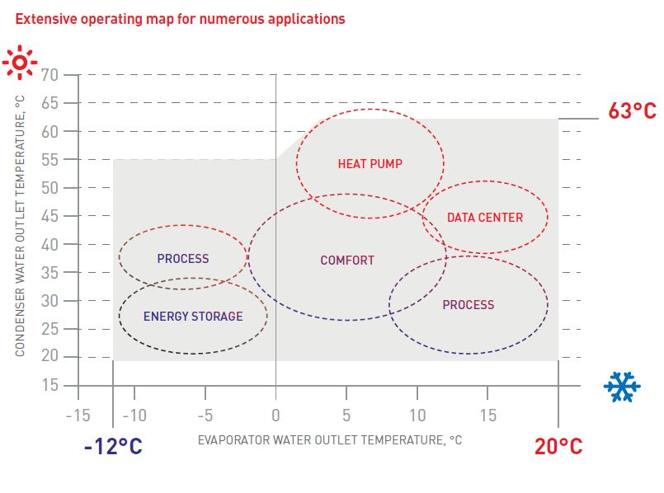
HYDROCIAT
FLEXIBILITY
  We design multifunctional solutions in order to operate in various applications and to work with different comfort units and evacuation outlets.
  The Hydrociat range is designed to work with all emitters: comfort units, underfloor heating, chilled beams, air handling units and radiators. It is also fully adapted to different evacuation outlets such as dry coolers or cooling towers.
  65°C
10/07/2023
- Hydrociat & Powerciat – customer presentation

Slide 30
HYDROCIAT
ADVANCED SYSTEM CONTROL
We optimize energy consumption while ensuring optimal occupant comfort using a set of interconnected services that simultaneously monitor all energy and water loop components.
CONNECT TOUCH
Power control
Abound HVAC Perfomance
CRISTO control
10/07/2023
- Hydrociat & Powerciat – customer presentation

Slide 31
A COMBINATION OF TECHNOLOGIES

Slide 32

A COMBINATION OF TECHNOLOGIES
Screw compressor
Electronic expansion valve
Economiser
Connect Touch
control
Flooded shell & tubes
evaporator
10/07/2023
- Hydrociat & Powerciat – customer presentation

Slide 33
MAXIMUM EFFICIENCY

Slide 34
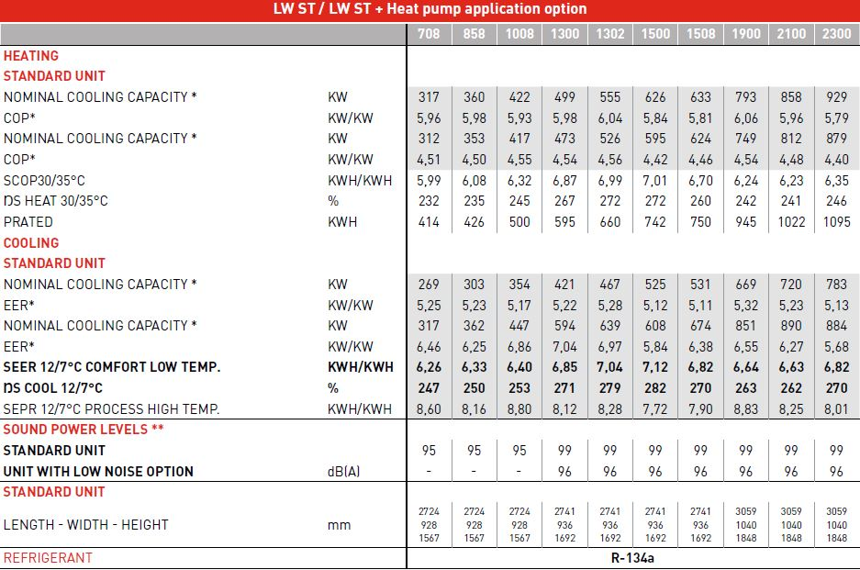
MAXIMUM EFFICIENCY
(1) In accordance with EN 14511-2013 EUROVENT Chilled water = 12°C/7°C Outside air = 35°C
Pf = Cooling capacity
EER = Full load performance coefficient
SEER12/7-SEPR12/7 = Seasonal performance coefficient in accordance with applicable Ecodesign regulation (EU) No 2016/2281
10/07/2023

Slide 35
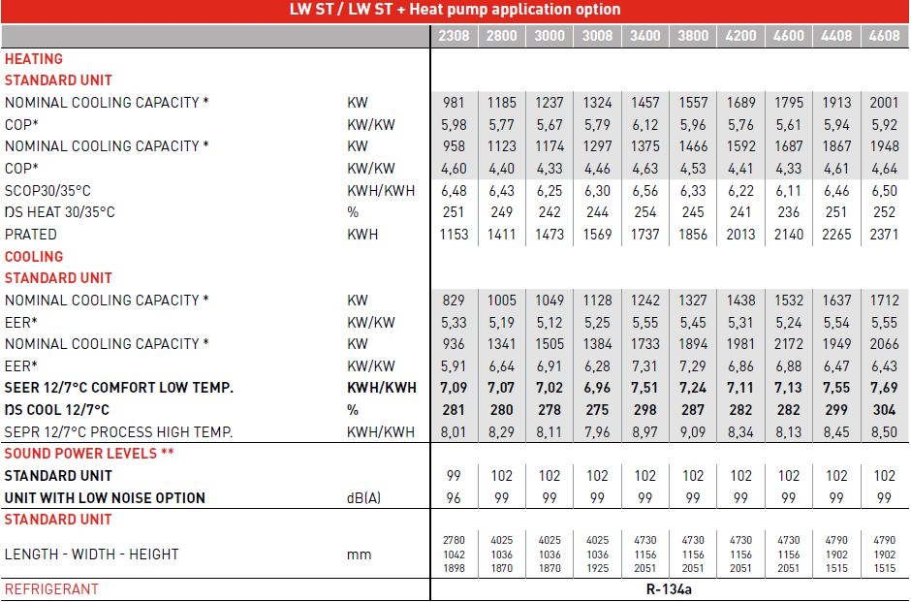
MAXIMUM EFFICIENCY
(1) In accordance with EN 14511-2013 EUROVENT Chilled water = 12°C/7°C Outside air = 35°C
Pf = Cooling capacity
EER = Full load performance coefficient
SEER12/7-SEPR12/7 = Seasonal performance coefficient in accordance with applicable Ecodesign regulation (EU) No 2016/2281
10/07/2023

Slide 36

MAXIMUM EFFICIENCY
(1) In accordance with EN 14511-2013 EUROVENT Chilled water = 12°C/7°C Outside air = 35°C
Pf = Cooling capacity
EER = Full load performance coefficient
SEER12/7-SEPR12/7 = Seasonal performance coefficient in accordance with applicable Ecodesign regulation (EU) No 2016/2281
10/07/2023

Slide 37
FEATURES AVAILABILITY
HYDROCIAT
Light-brine solution, down to -3°C |  | Control for low cond. temperature |  | Low noise level | ❐
Unit supplied in two assembled parts | 4228-4408-4608-4628 | Compliance with Swiss regulations |  | Evap. dual pumps power/control circuit | ❐
Evap. single pump power/control circuit | 708-3428 | Compliance with Morocco regulation |  | Thermal compressor insulation | 
230V electrical plug |  | Dual relief valves on 3-way valve |  | Cond. single pump power/control circuit | ❐
Evaporator with one pass less |  | Compliance with Russian regulations |  | Anti-vibration mounts | 
Master/slave operation |  | Bacnet over IP |  | Set point adjustment by 4-20mA signal | 
Condenser with one pass less |  | High condensing temperature | Available for all LW HE, LW ST 708 / 858 / 1008, and for higher LW ST sizes only with heat pump application option | Free Cooling dry cooler management | 
21 bar evaporator |  | Condensing temperature limitation |  | Heat Pump application | 
Single power connection point | 2800/4628 | Flanged evaporator water connection kit | 
21 bar condenser |  | Specific dry cooler control | 
Reversed evaporator water connections |  | Flanged condenser water connection kit | 
Reversed condenser water connections |  | Energy Management Module | 
Condenser insulation |  | 7" user interface | 
Service valve set |  | Input contact for Refrigerant leak detection | 
Lon gateway |  | Compliance with Australian regulations | 
Supplied as standard | 

Slide 38

ADVANCED SYSTEM CONTROL

Slide 39
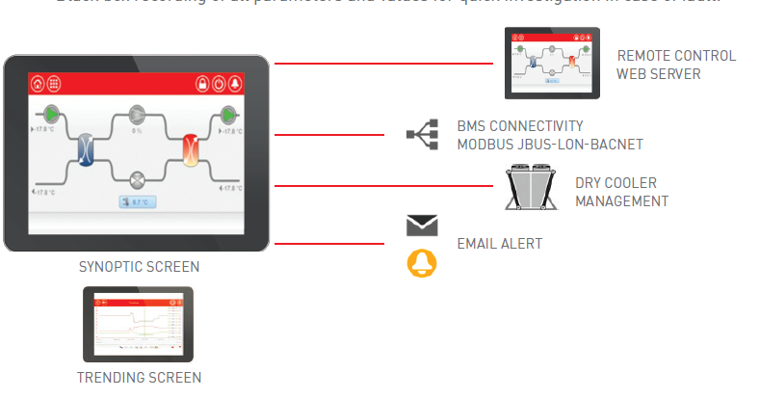
CONNECT touch
Manage your installation intuitively with Connect Touch’s smart monitoring.
10/07/2023
- Hydrociat & Powerciat – customer presentation
39

Slide 40
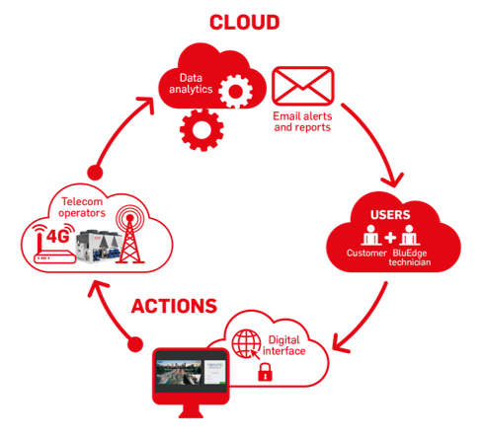
Abound HVAC Perfomance
Abound HVAC Perfomance is an advanced monitoring solution which enables customers for all applications to track and monitor their CIAT equipment.
  Real-time data thanks to a customized access to our IoT platform (synoptic, dashboard, temperature/event curves, alerts and fault memory and parameter history)
  Email alert for any event concerning the equipment.
  Monthly and annual reports with analysis and recommendations from CIAT experts.
10/07/2023
- Hydrociat & Powerciat– customer presentation

Slide 41
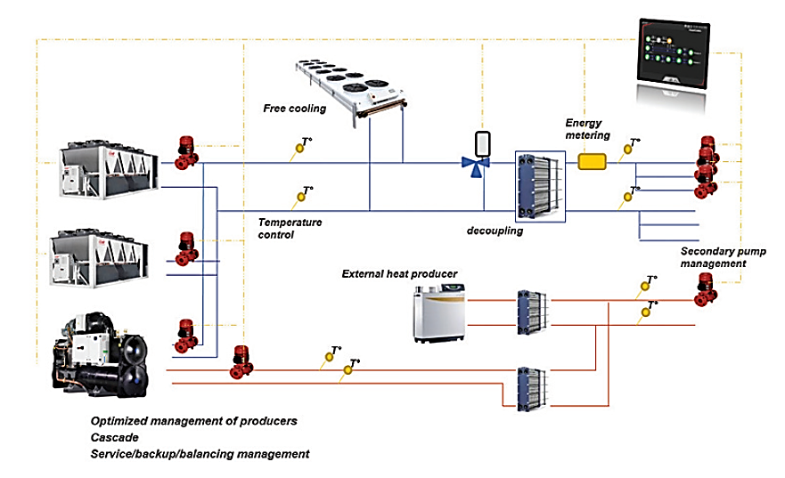
Power’CONTROL
Power'Control is the plant management tool for your Energy Hub solution.
It optimizes energy for high-performance systems and is designed to control a complete thermal energy production system (cooling and heating).
10/07/2023
- Hydrociat & Powerciat – customer presentation
41

Slide 42
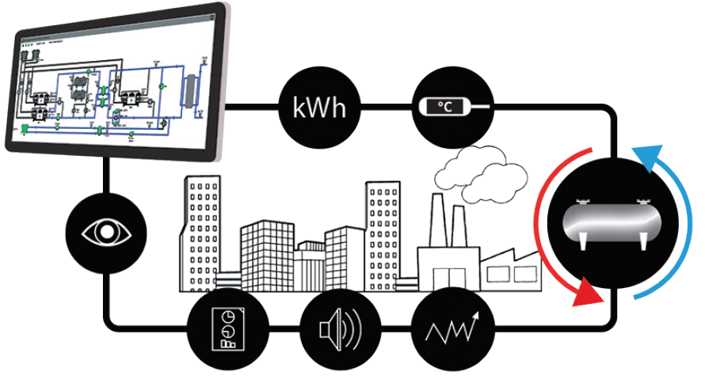
CRISTO’CONTROL
  Cristo’control is a piloting, controlling and monitoring system dedicated to Thermal Energy Storage (TES) installations.
  Allows contractors and owners to reduce operating cost.
  Optimises energy usage while lowering CO2 and greenhouse gas emissions.
  Provides performance measures.
  Monitors support, preventive and curative maintenance, using both local and remote control.
10/07/2023
- Hydrociat & Powerciat – customer presentation
42

Slide 43
Our references

Slide 44
Customer Reference
Customer – city – country
Application
Project
xxx
Customer’s challenges
xxx
CIAT’s solution
xxx

Slide 45

CIAT
AT YOUR SERVICE
      At CIAT, our objective is to develop partnerships with you and provide high quality service throughout the lifecycle of your HVAC system. We understand your changing needs and develop smart services and energy solutions that optimise energy performance and enable savings.
      We provide the support you need to get the most out of your solution:
      • Preventive and corrective service maintenance.
      • On-site inspection by experts close at hand.
      • Online parts shop.
      • Dedicated hotline for off-site technical support.
      We also offer you a comprehensive range of smart
      services:
      • Consulting on energy performance upgrade.
      • Advanced monitoring and plant system
      management solutions.
      • Equipment and system modernization.

Slide 46
Thank you for your attention

Slide 47
Name
  Title
  Business unit
    +33 (0)000000000
    email

Slide 48
A CARRIER COMPANY
The materials and information referenced in this presentation are for informational purposes only and not for the purpose of providing legal or other professional advice.
©2020 Carrier. All Rights Reserved. CIAT reserves the right to change certain information and specifications contained in this document at any time and without prior notice.
Availability depends on each country. Please contact your CIAT representative.
Hydrociat & Powerciat – English –October 2020
Photos: CIAT, istock

