Slide 1

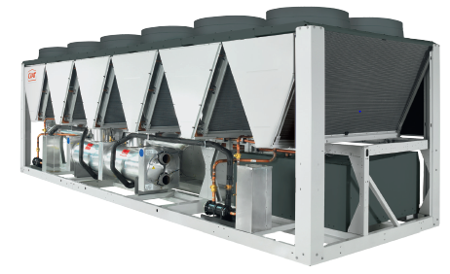

AIR-COOLED CHILLERS
POWERCIAT

Slide 2





energy EFFICIENT MULTI-PURPOSE COOLING
Nominal Cooling Capacity: 270 to 1,500 kW
2
Notes:
As a pioneer of customised HVAC solutions, CIAT understands the importance of increasing the
well-being of individuals in their living areas and places of work. Aware of the thermal, energy and
air quality issues faced today by every sector of activity, we have responded by developing global
systems based on an adapted and efficient combination of products.

Slide 3
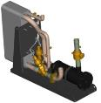
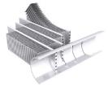

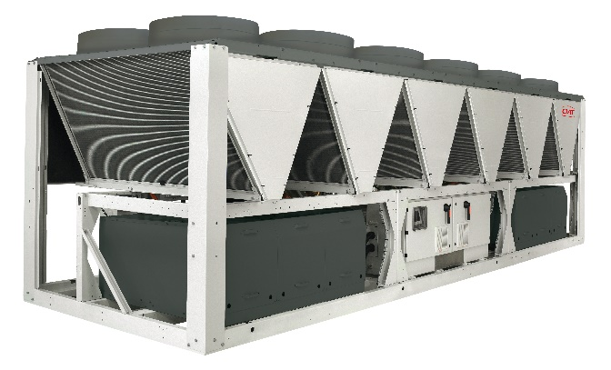
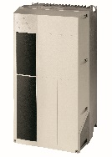



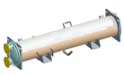
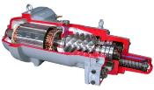
Design
Economiser
Variable speed fans
AC motor+drive (HE version)
Micro-channel condenser coil
Variable speed fans
EC motor
(XE version)
Connect Touch control
Flooded Shell&Tubes
evaporator
Screw compressor
3

Slide 4

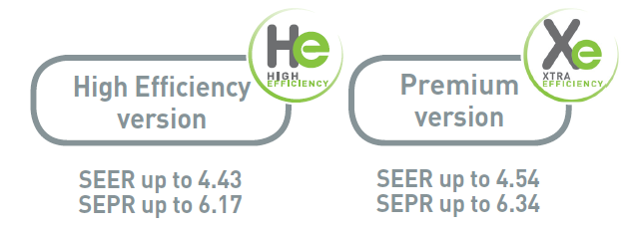
Energy Efficiency
Fixed speed screw compressor
Variable speed AC fans
Ecodesign regulation for Process and Comfort Cooling applications
Fixed speed screw compressor
EC Fans technology
Ecodesign regulation for Process and Comfort Cooling applications
4

Slide 5
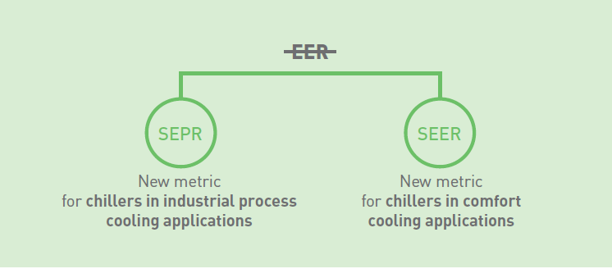
New seasonal performance metrics
From January 2018, new energy efficiency requirements come into force with the latest European Ecodesign regulation for chillers. Now, and in the future, the focus is on seasonal efficiency.
5
Notes:
EER full load efficiency belongs to the past. Now, and in the future, the focus is on seasonal efficiency. The Seasonal Energy Performance Ratio (SEPR) and the Seasonal Energy Efficiency Ratio (SEER) ensure precised evaluations of actual operations throughout the year, including seasonal variations in their measurements.

Slide 6
Energy savings
The recovery of the total heating capacity supplied by the chiller enables the unit to produce free additional hot water up to 60°C.
100%
Chilled Water Production
30%
Energy
130%
Domestic Hot Water Reproduction by Recovery
6

Slide 7

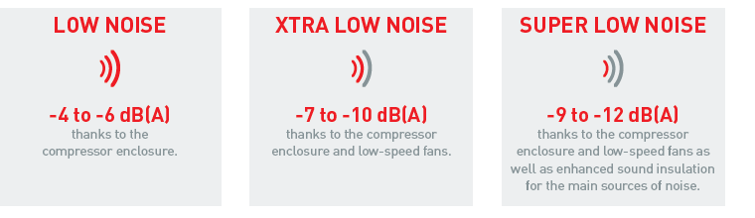
Noise-reduction technologies
Thanks to the noise-reduction technologies used in the new POWERCIAT range, you can guarantee a low noise level and no vibrations.
7

Slide 8

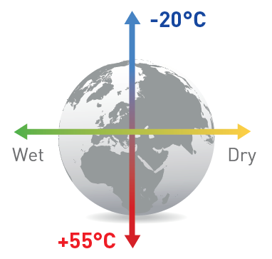
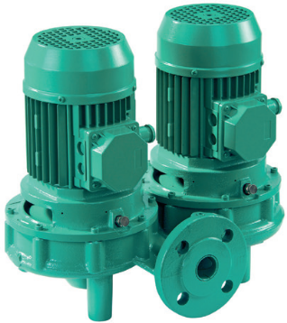
SIMPLICITY
POWERCIAT provides an extended chilled water outlet temperature range of -15°C (with low-brine option) to 15°C.
With an extended operating outdoor temperature range from -20°C to +55°C, POWERCIAT is adaptable to all climates, in all seasons.
POWERCIAT range provides an all-in-one solution thanks to the integrated hydraulic module which contains all the water circuit components needed for the system to operate correctly. Hydraulic module are available from sizes 270 to 500 kW and can be equipped with a large choice of pumps:
• Single or twin with automatic switchover to the
emergency pump.
• Fixed speed high or low pressure pump.
8

Slide 9
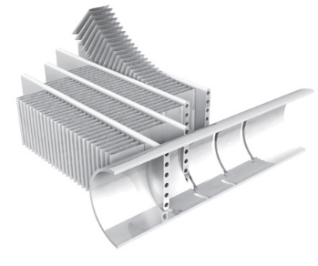
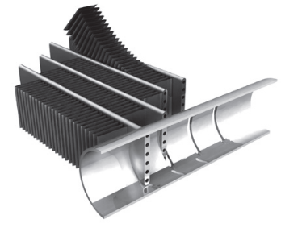
SIMPLICITY
With two dedicated coating options for aggressive and corrosive environments, POWERCIAT operates smoothly even in the harshest environmental situations:
Protect2 treatment is the ideal solution for moderately-corrosive urban environments, doubling resistance to corrosion. The coil is immersed in a bath to ensure 100% coverage and protection, as the aluminum surface undergoes a chemical change by a nano scale conversion process.
For highly corrosive industrial and marine environments, the Protect4 treatment increases resistance to corrosion fourfold. The coil is e-coated in polymer epoxy and a top layer of anti-UV protection is applied.
9

Slide 10

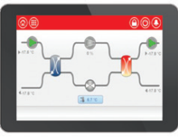
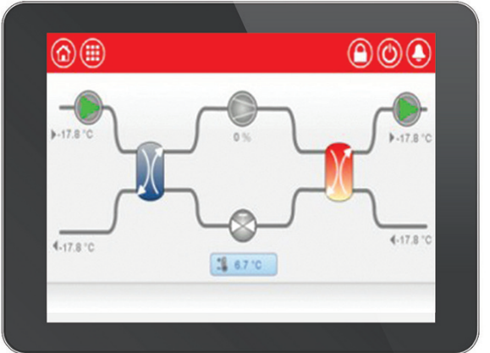





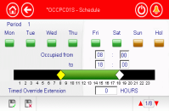
Advanced system control
Manage your installation intuitively with Connect Touch’s smart monitoring.
REMOTE CONTROL
WEB SERVER
BMS CONNECTIVITY
MODBUS JBUS-LON-BACNET
LANGUAGE & PASSWORD
EMAIL ALERT
DRY COOLER
MANAGEMENT
SYNOPTIC SCREEN
SCHEDULE
10
10

Slide 11
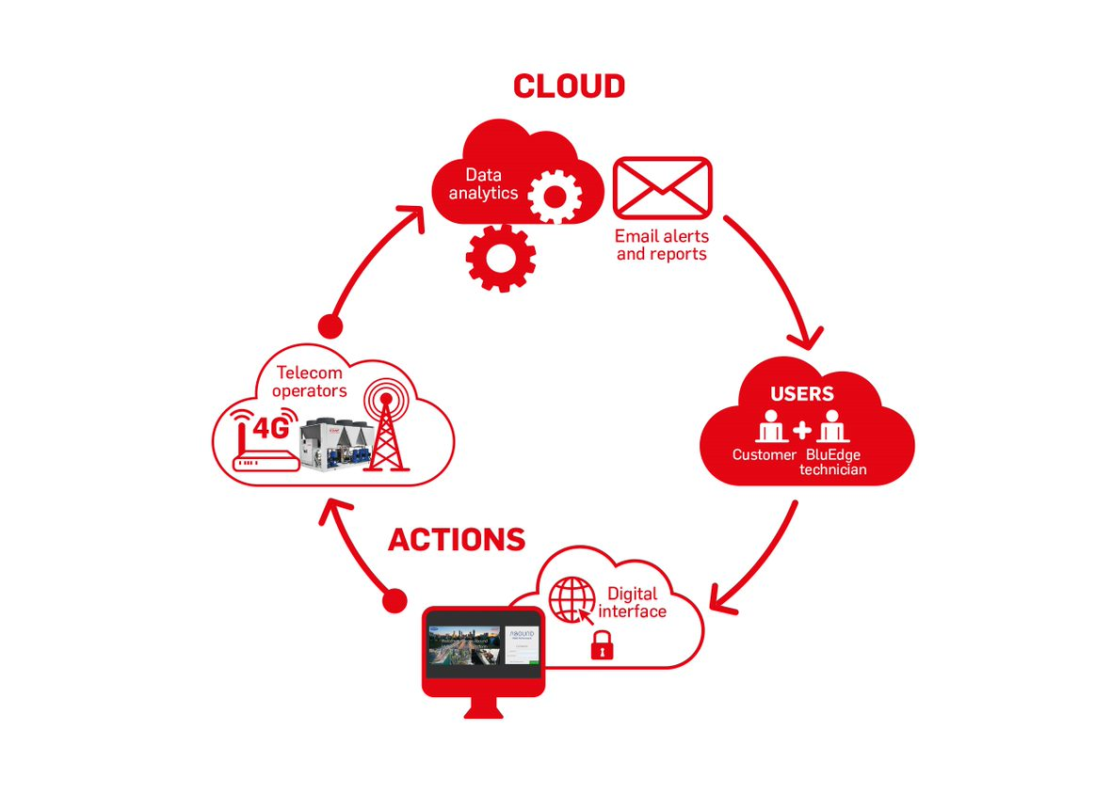
Abound is an advanced monitoring solution which enables customers for all applications to track and monitor their CIAT equipment.
11

Slide 12
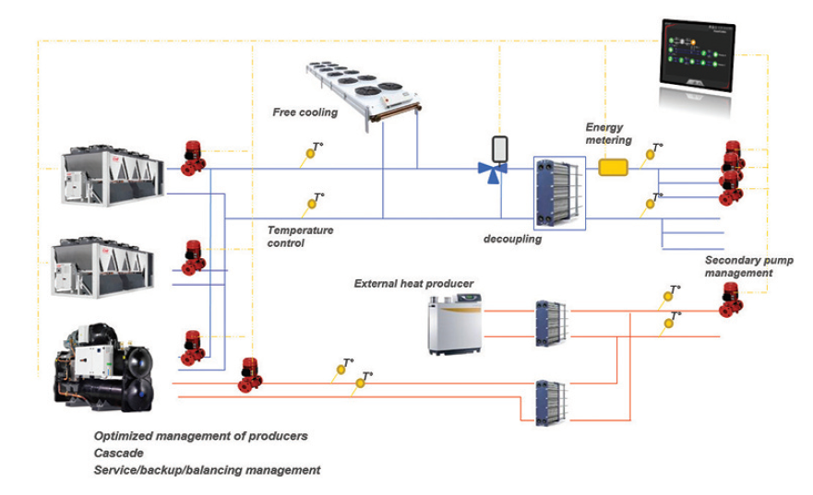
Power’control
Power'Control is the plant management tool for your Energy Hub solution. It optimizes energy for high performance systems and is designed to control a complete thermal energy production system (cooling and heating).
12

Slide 13
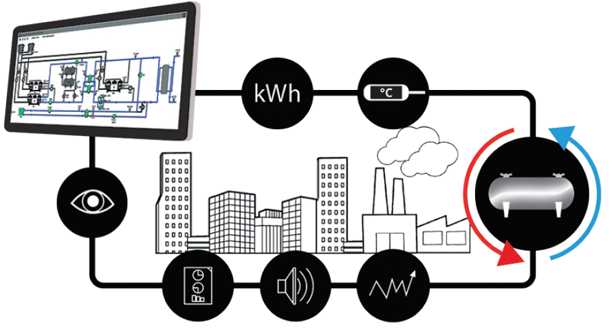
Cristo’control
Piloting, controlling and monitoring system dedicated to Thermal Energy Storage (TES) installations.
Allows contractors and owners to reduce operating cost
Optimise their energy use while lowering CO2 and greenhous gas emissions
Provides performance measures
Monitors support, preventive and curative maintenance, using both local and remote control.
13

Slide 14
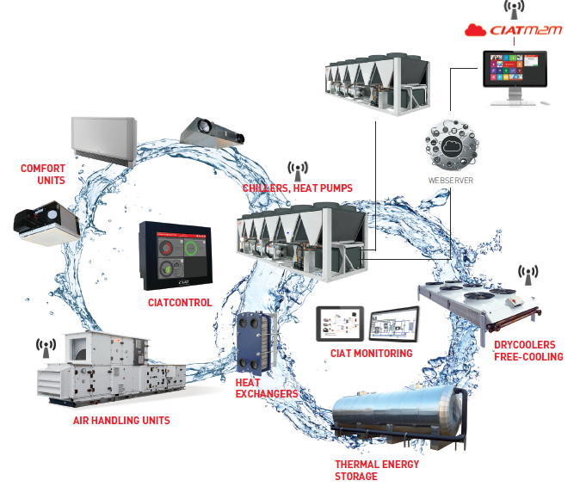

GLOBAL SYSTEM PROVIDER
14
Notes:
As a pioneer of customised HVAC solutions, CIAT understands the importance of increasing the
well-being of individuals in their living areas and places of work. Aware of the thermal, energy and
air quality issues faced today by every sector of activity, we have responded by developing global
systems based on an adapted and efficient combination of products.

Slide 15




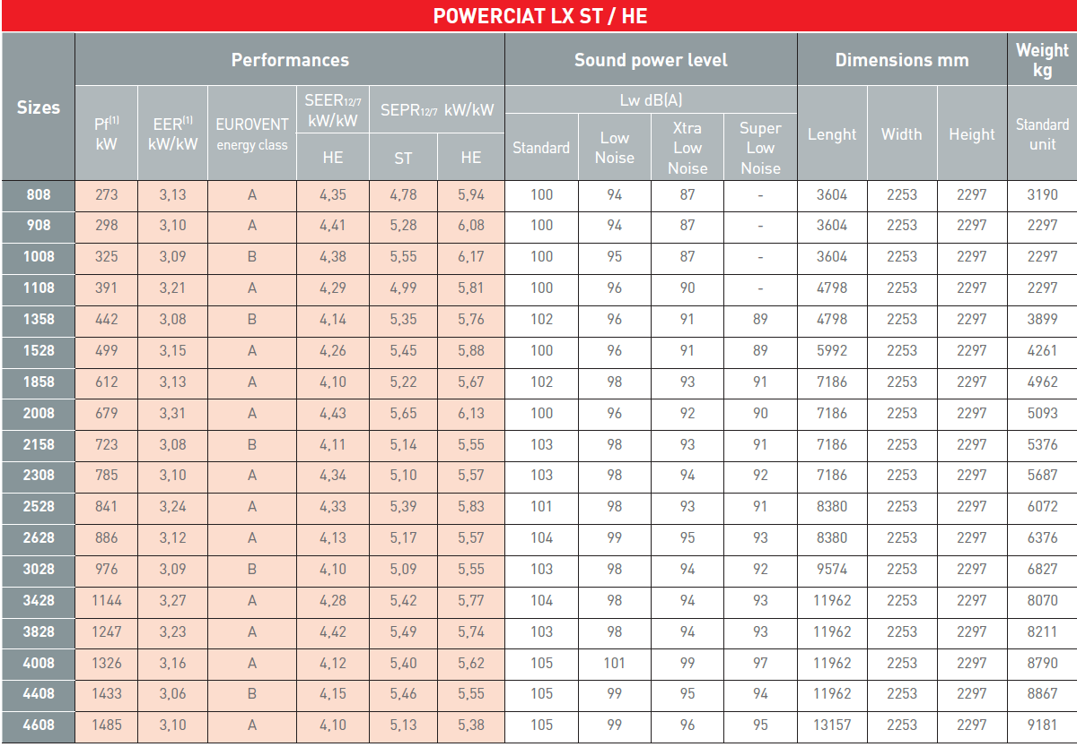
(1) In accordance with EN 14511-2013 EUROVENT Chilled water = 12°C/7°C Outside air = 35°C
Pf = Cooling capacity
EER = Full load performance coefficient
SEER12/7-SEPR12/7 = Seasonal performance coefficient in accordance with applicable Ecodesign regulation (EU) No 2016/2281
15
Notes:
As a pioneer of customised HVAC solutions, CIAT understands the importance of increasing the
well-being of individuals in their living areas and places of work. Aware of the thermal, energy and
air quality issues faced today by every sector of activity, we have responded by developing global
systems based on an adapted and efficient combination of products.

Slide 16

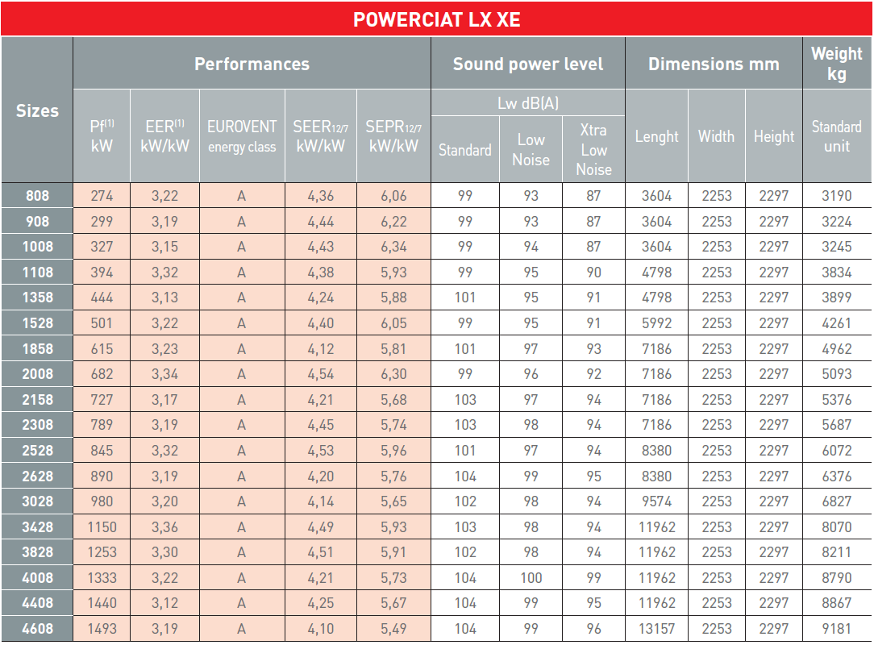
(1) In accordance with EN 14511-2013 EUROVENT Chilled water = 12°C/7°C Outside air = 35°C
Pf = Cooling capacity
EER = Full load performance coefficient
SEER12/7-SEPR12/7 = Seasonal performance coefficient in accordance with applicable Ecodesign regulation (EU) No 2016/2281
16
Notes:
As a pioneer of customised HVAC solutions, CIAT understands the importance of increasing the
well-being of individuals in their living areas and places of work. Aware of the thermal, energy and
air quality issues faced today by every sector of activity, we have responded by developing global
systems based on an adapted and efficient combination of products.

Slide 17
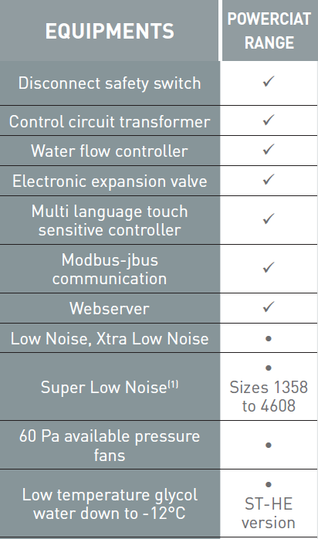
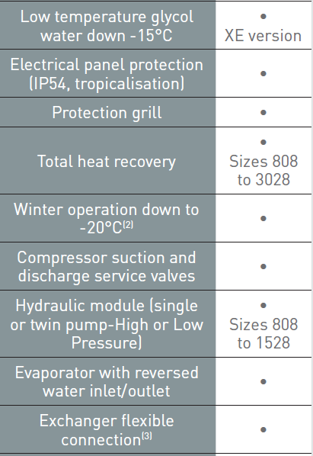
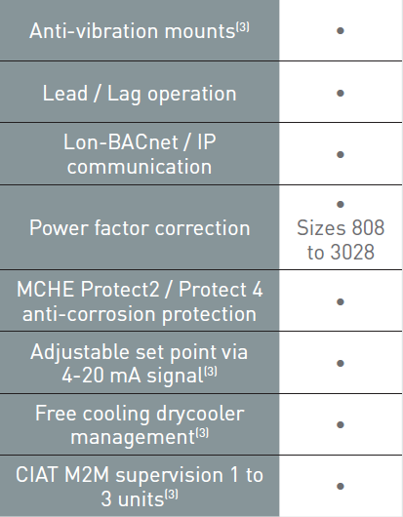
Options
✓Standard equipment
• Option
(1) Available during 2018 for XE version
(2) Standard equipment for HE-XE versions
(3) Available during 2018
17

Slide 18

Ciat: at your service
At CIAT, our objective is to develop partnerships with you and provide high quality service throughout the lifecycle of your HVAC system. We understand your changing needs, and develop smart services and energy solutions that optimise energy performance and enable savings.
18

Slide 19
Thank you

