Slide 1
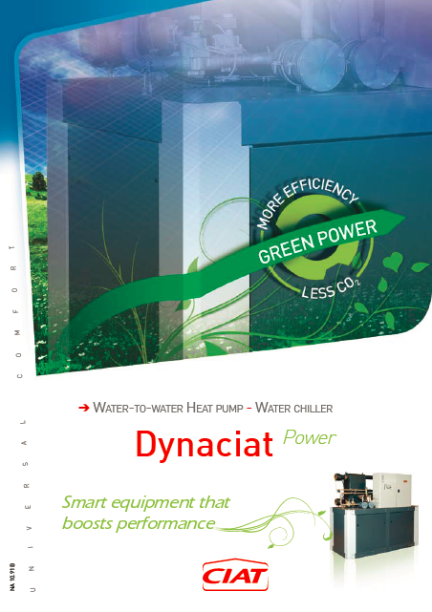

Slide 2
AGENDA
RANGE
DESIGN
EFFICIENCY-COMPETITIVENESS
RUNNING LIMIT
SOUND LEVEL
ACCESSIBILITY-HYDRAULIC
CONTROL
OPTIONS
LGN serial

Slide 3
AGENDA
RANGE
DESIGN
EFFICIENCY-COMPETITIVENESS
RUNNING LIMIT
SOUND LEVEL
ACCESSIBILITY-HYDRAULIC
CONTROL
OPTIONS
LGN serial

Slide 4





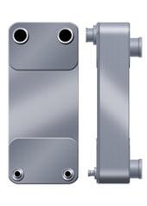

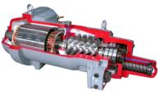

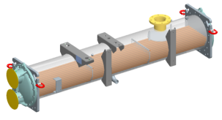

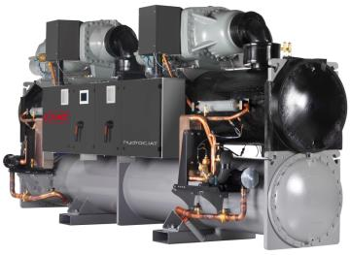

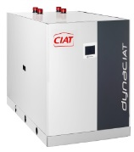
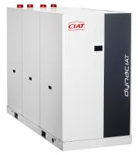
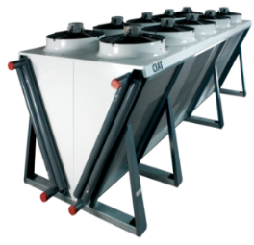
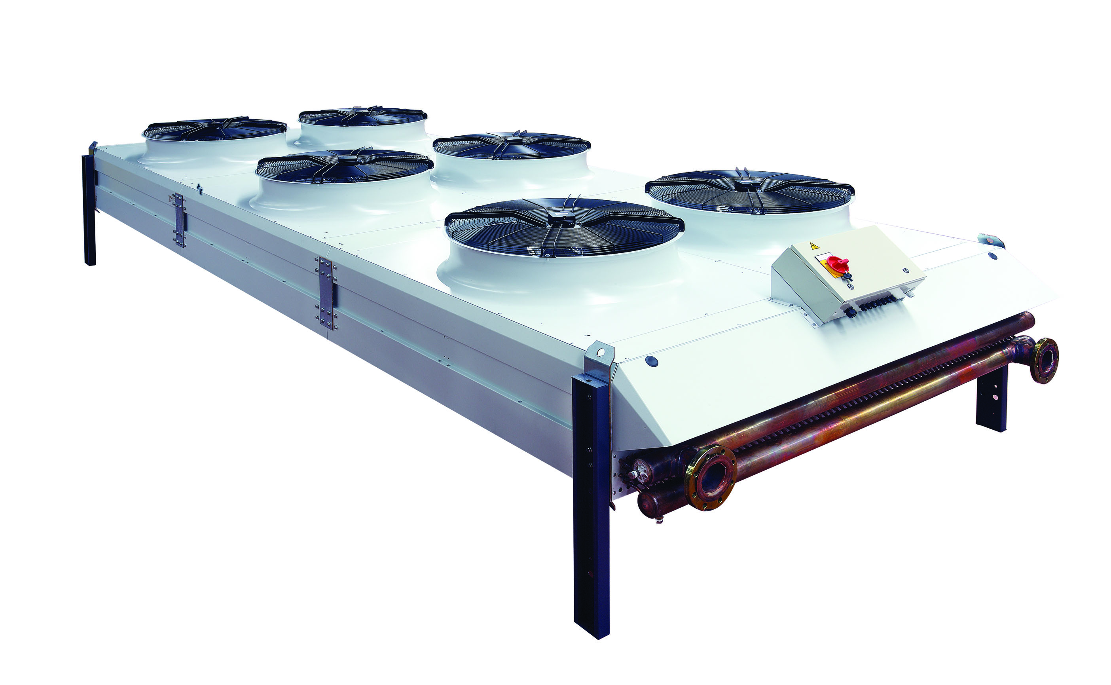
WC Range
20
30
90
200
500
700
1000
1700
HYDROCIAT^{TURBO}
kW
HYDROCIAT
DYNACIAT
DYNACIAT^{POWER}
+
Wide range: an answer adapted to each needs
VEXTRA
OPERA

Slide 5




11 sizes of water / water chiller and heat pump
LG Cooling capacity from 200 to 700 kW
LG Heating capacity from 250 to 820 kW
3 ACOUSTICS VERSIONS
STD – LN - XLN

Slide 6
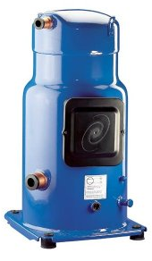
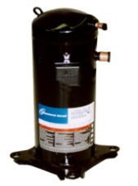
The range
2 refrigerant circuits
700V
800V
900V
1000V
1100V
1200V
1400V
1600V
1800V
2100V
2400V

Slide 7

The range
Cooing cap.
Pf kW
Chilled water = 12°C / 7°C Hot water = 30°C / 35°C

Slide 8
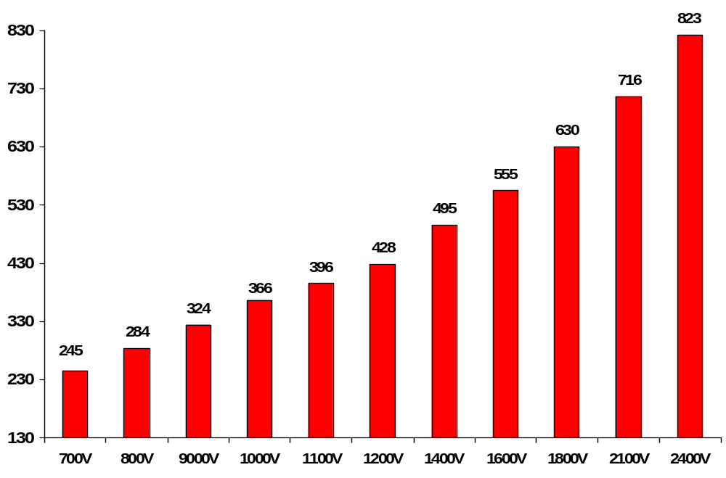

The range
Pc kW
Heat
pump
Hot water = 40°C / 45°C Chilled water inlet = 10°C with same water flow than cooling mode

Slide 9
AGENDA
RANGE
DESIGN
EFFICIENCY-COMPETITIVENESS
RUNNING LIMIT
SOUND LEVEL
ACCESSIBILITY-HYDRAULIC
CONTROL
OPTIONS
LGN serial

Slide 10
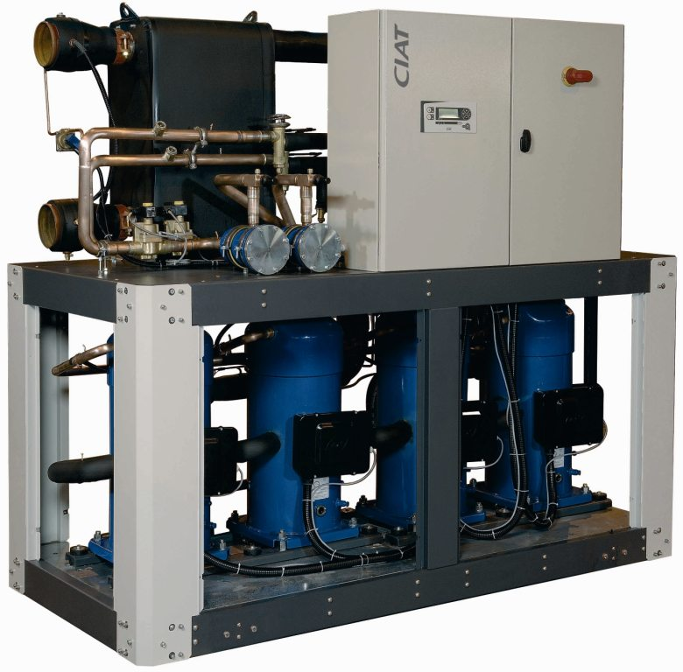
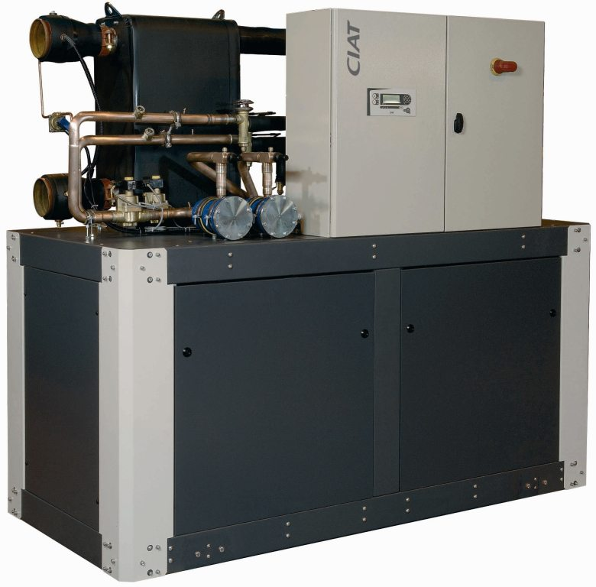
Design
STANDARD VERSION
LN – XLN VERSIONS
Notes:
La filosofía modular de este equipo puede verse claramente en la construcción del mismo en función de la potencia frigorífica que se necesita. Básicamente, cada módulo es una batería en V que ocupa menos espacio con esta disposición. Según aumentamos la potencia, vamos aumentando el número de módulos respetando siempre una construcción de tipo túnel.
Como podemos observar en el dibujo la filosofía que se sigue es la de tener un equipo abierto por los dos laterales para tener acceso fácil y rápido a todos los componentes.
El grupo hidraúlico se situaría en uno de los extremos del equipo y en el opuesto se encuentra el cuadro eléctrico.

Slide 11
Design
Compact units
up to 200 kW / m²
H
W
L
Modèles | Pf kW | Dimensions (mm)
 |  | L | P | H
700V à 1200V | 218 à 386 | 2099 | 996 | 1869
1400V à 1600V | 444 à 500 | 2499 |  | 1970
1800V à 2400V | 584 à 716 | 3350

Slide 12
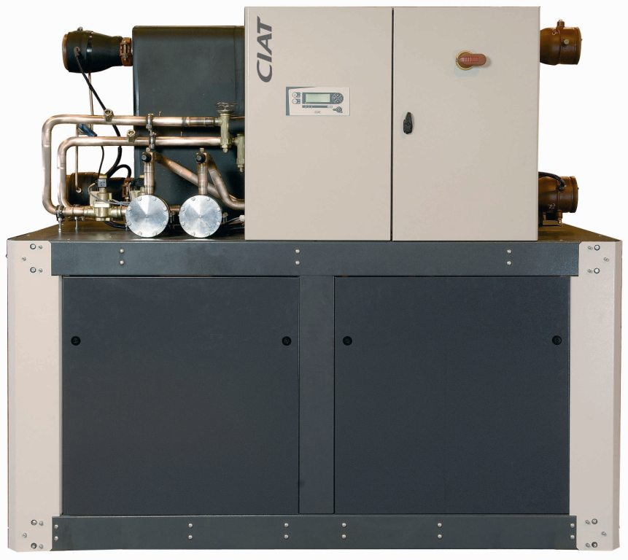
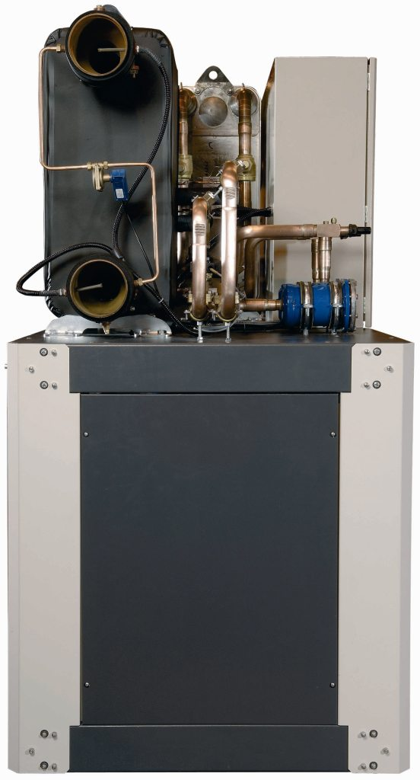
Design
Foot print reduced
40% to 50% vs Screw Solution
Easy integration in all
technical rooms
990 mm

Slide 13
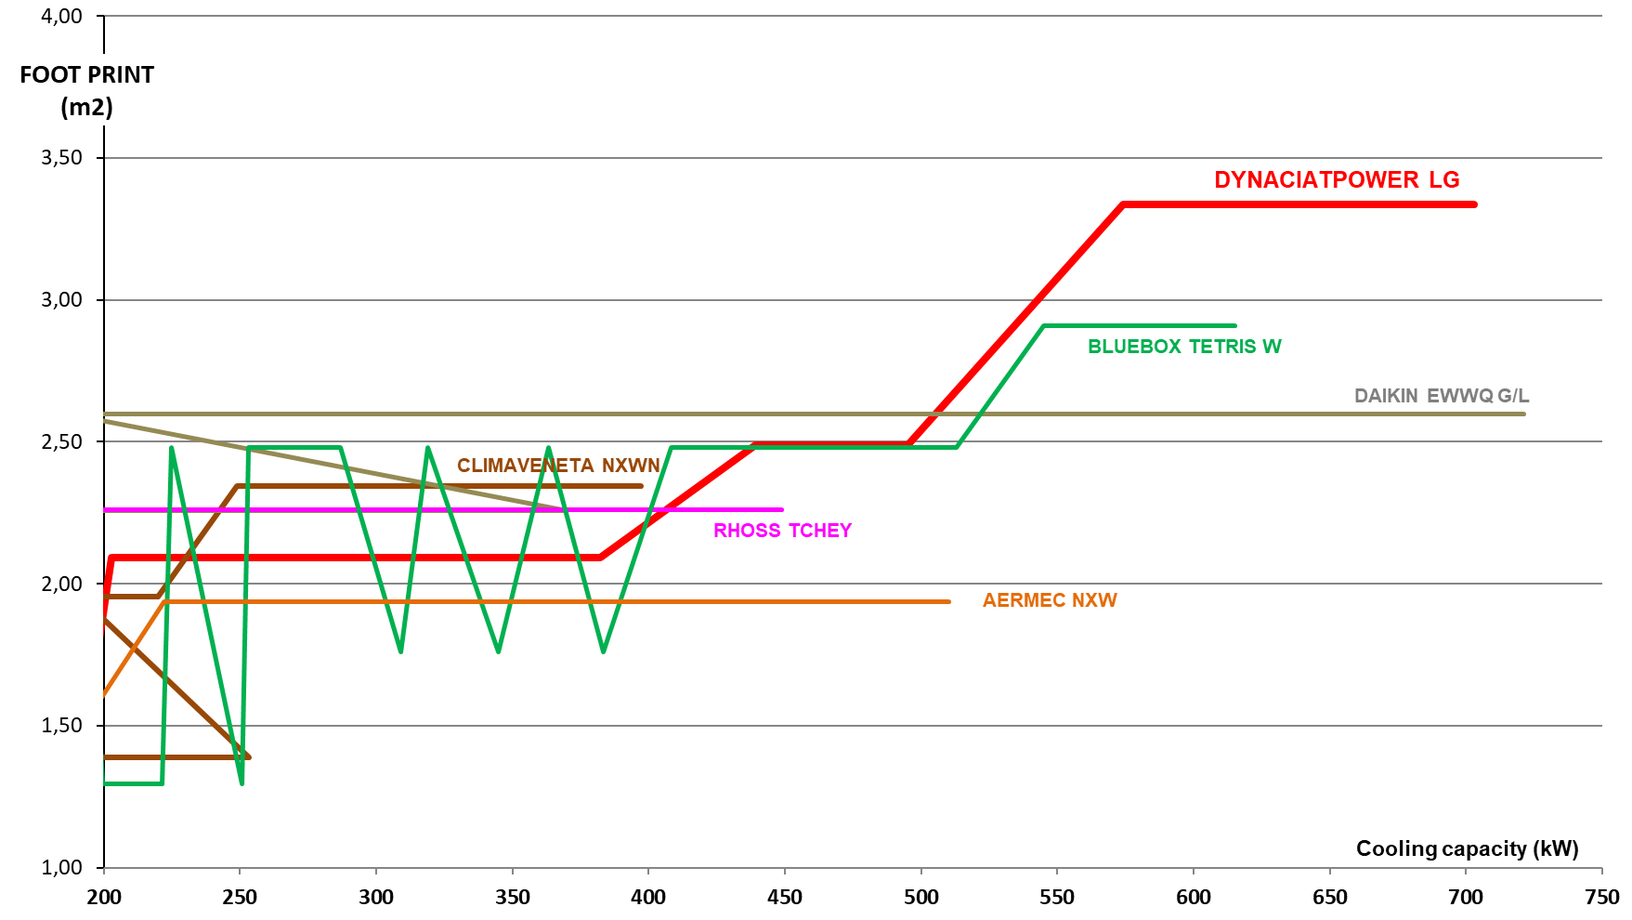
Benchmark Foot Print
DYNACIAT^{POWER} foot print is similar than competition

Slide 14

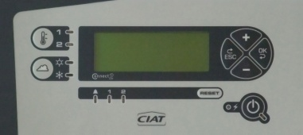
Components
Latest generation of scroll compressors
2 refrigerant circuits brazed plates evaporator
=
2 refrigerant circuits brazed plates condenser
CIAT Controller CONNECT2

Slide 15
Brazed plates heat exchanger
Maximum cooling capacity in a minimum place
Reduction of refrigerant charge
High efficiency vs shell and tubes
Plates in stainless stell 316L
VICTAULIC connection
Water differential pressure switch mounted
ARMAFLEX thermal insulation

Slide 16
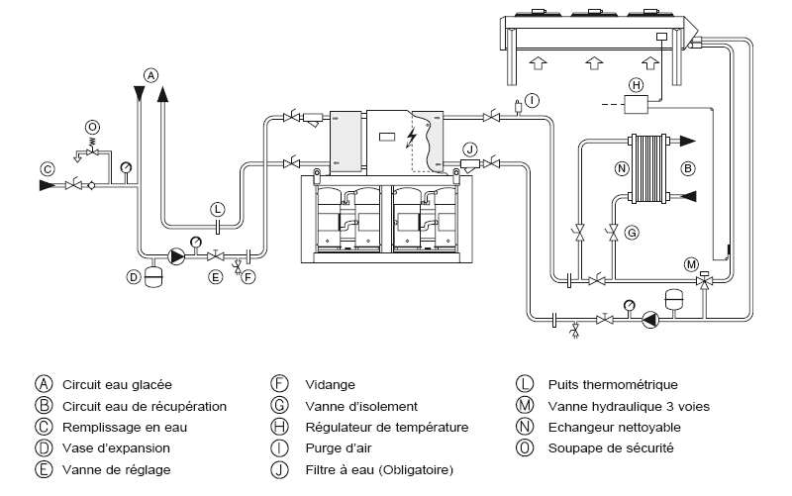
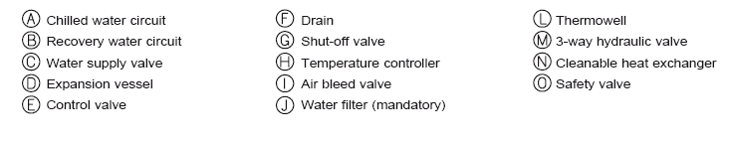
FUNCTIONAL DRAWING
COOLING WITH DRY-COOLER

Slide 17
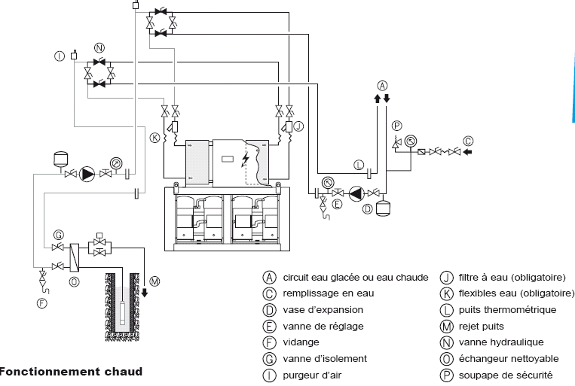
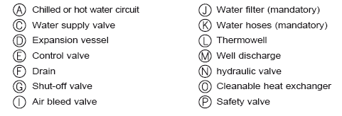
FUNCTIONAL DRAWING
HEATING/COOLING HYDRAULIC INVERSION
COOLING OPERATION

Slide 18
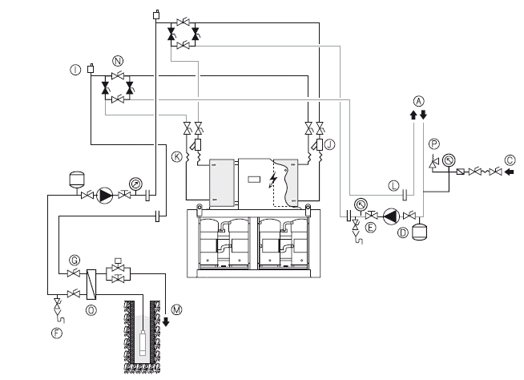
FUNCTIONAL DRAWING
HEATING/COOLING HYDRAULIC INVERSION
HEATING OPERATION

Slide 19
AGENDA
RANGE
DESIGN
EFFICIENCY-COMPETITIVENESS
RUNNING LIMIT
SOUND LEVEL
ACCESSIBILITY-HYDRAULIC
CONTROL
OPTIONS
LGN serial

Slide 20
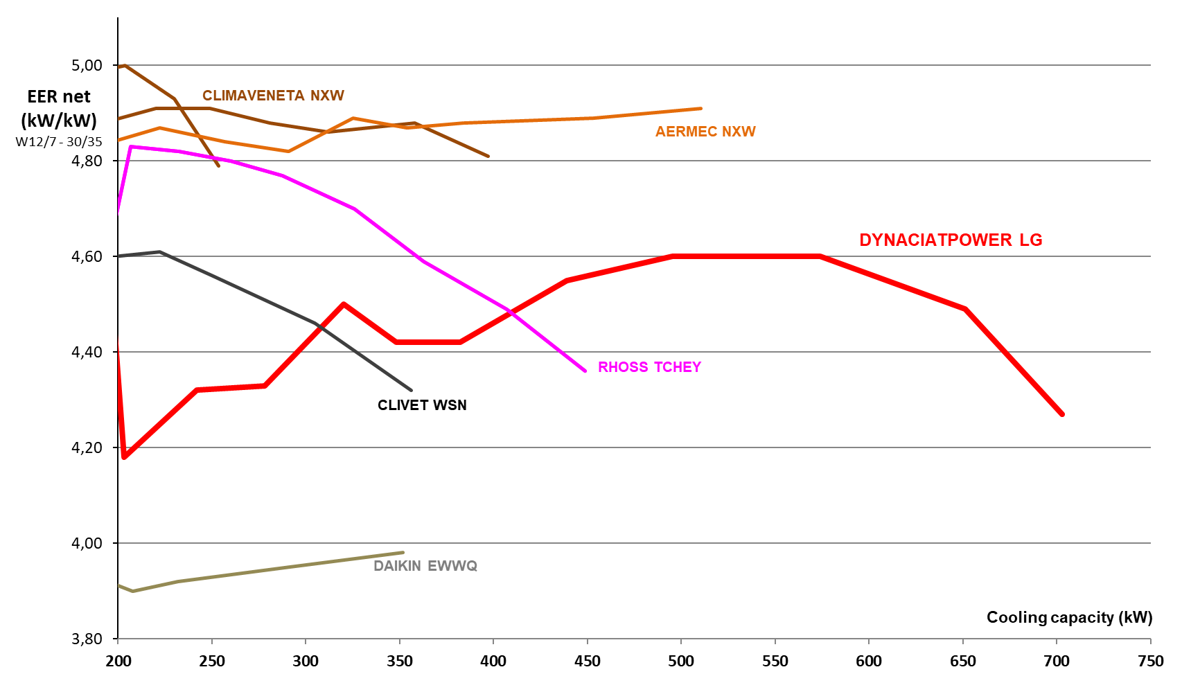
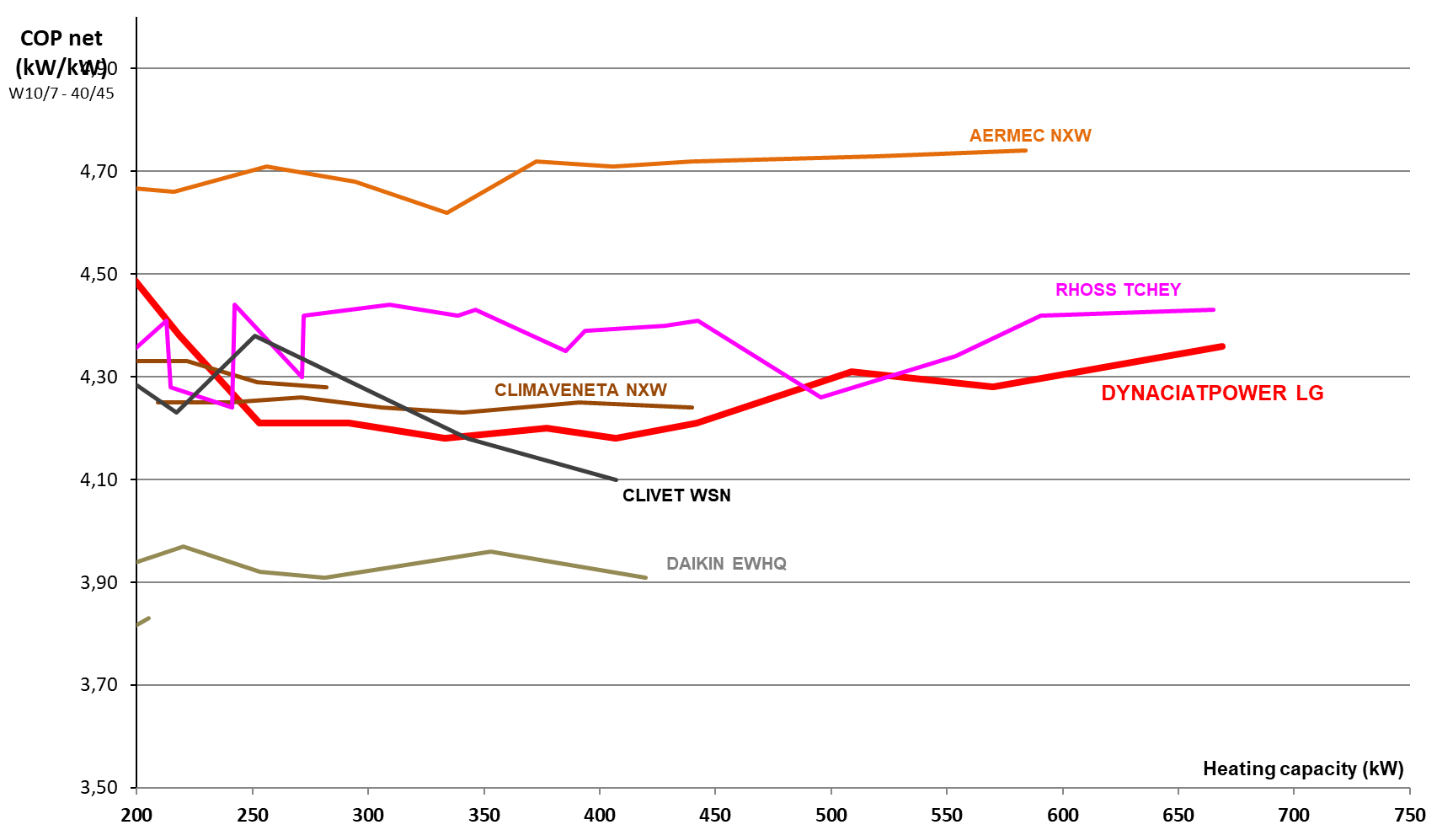
FULL LOAD PERFORMANCES
EER
COP
Do not focus on the EER It accounts for only 3% of the annual power consumption
In HVAC let us focus on the annual energy efficiency SEER & SCOP
In Process let us focus on SEPR

Slide 21
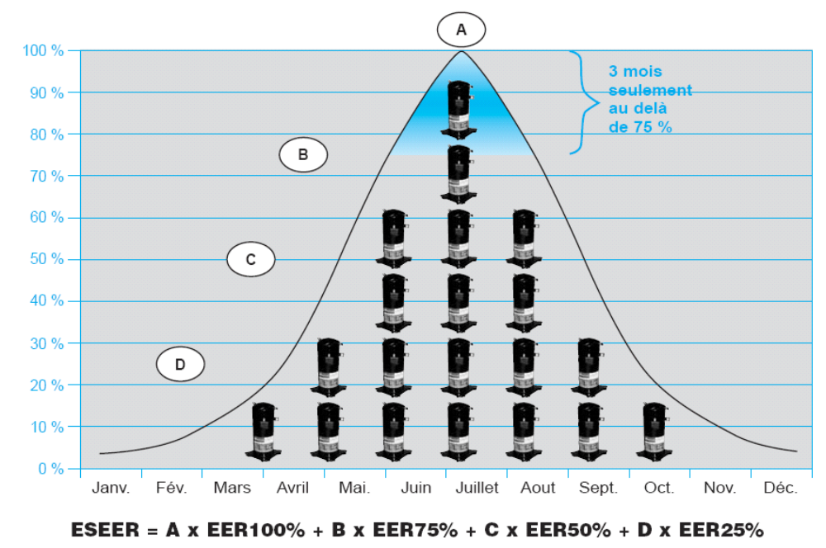
SCROLL technology
Seasonal optimization
Seasonal thermal load
Only
3 months
above 75%

Slide 22
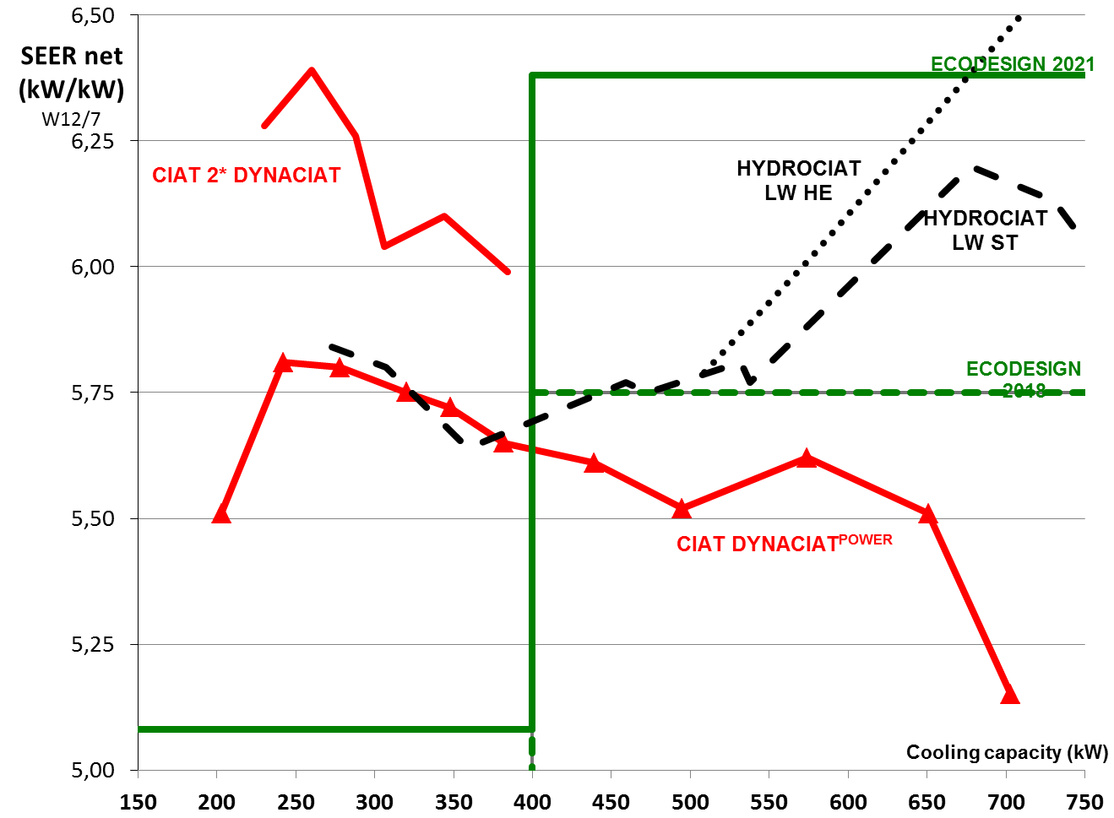
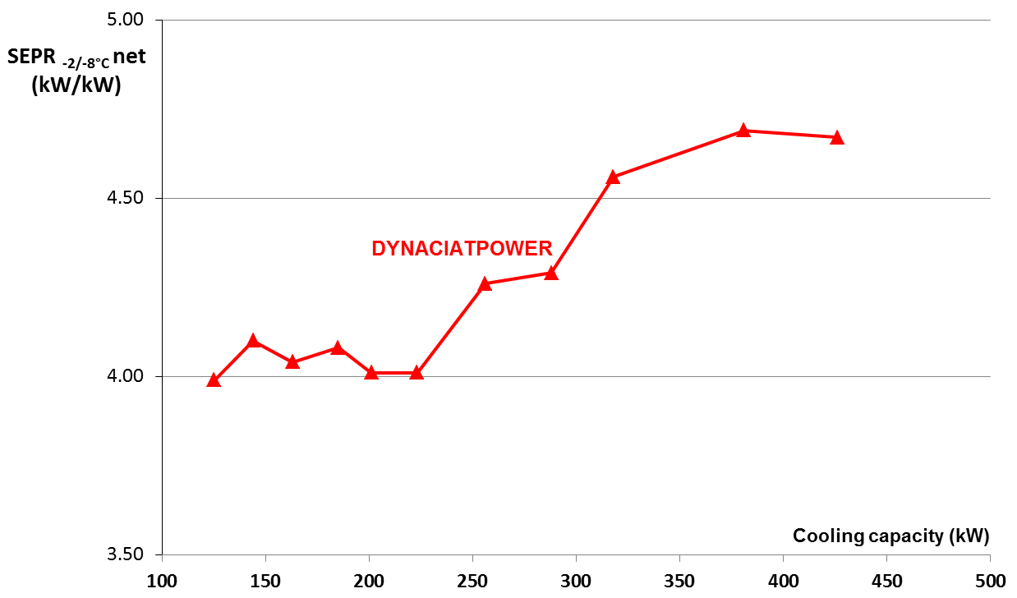
SEASONAL PERFORMANCES – Part Load
COMFORT SEER
PROCESS SEPR
PROCESST N° 2015/1095 ENTR Lot 1
<300 = 3.29 >300 = 4.37
Up to 400kW DYP LG is efficient as a screw solutions
✓ ECODESIGN Process SEPR
ECODESIGN 2021 SEER up to 400kW

Slide 23
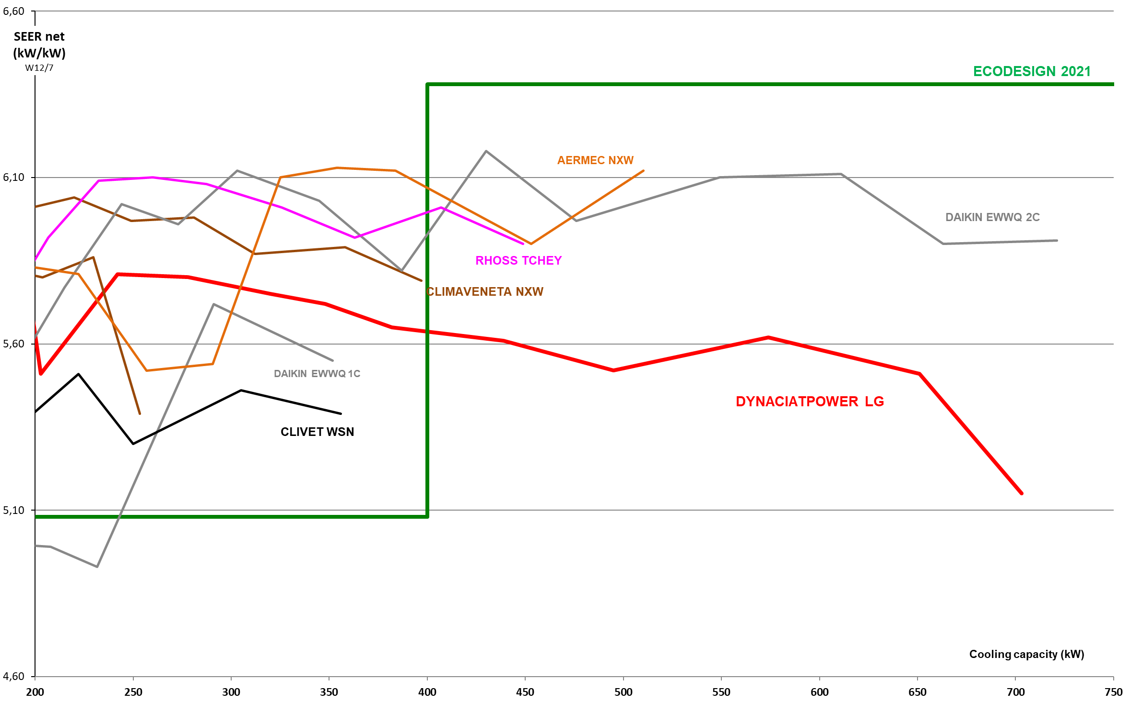
SEASONAL PERFORMANCES – Part Load
COMFORT SEER
Bellow 400kW performances similar to competition
No Scroll offer SEER compliance > 400kW
Units > 400kW sales as HP (SCOP)

Slide 24
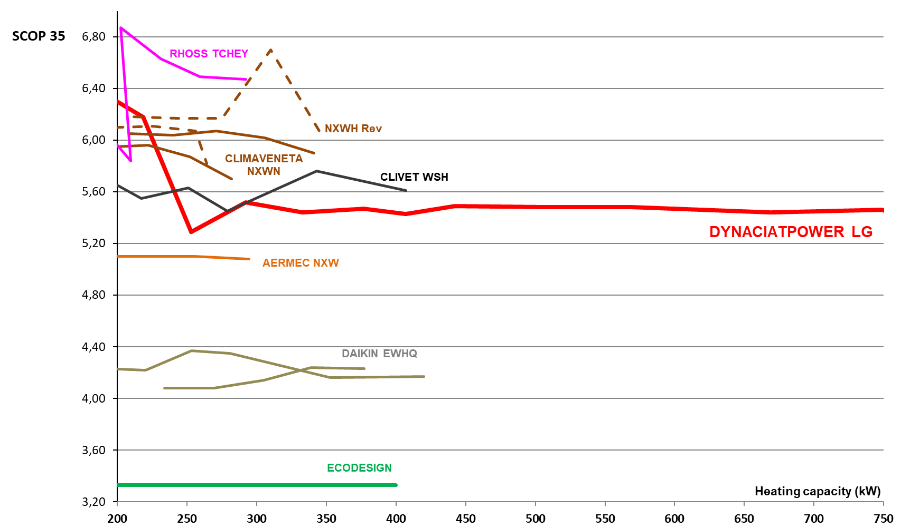
SEASONAL PERFORMANCES – Part Load
SCOP
No datas from competition over 400kW
(Ecodesign limit for HP)

Slide 25
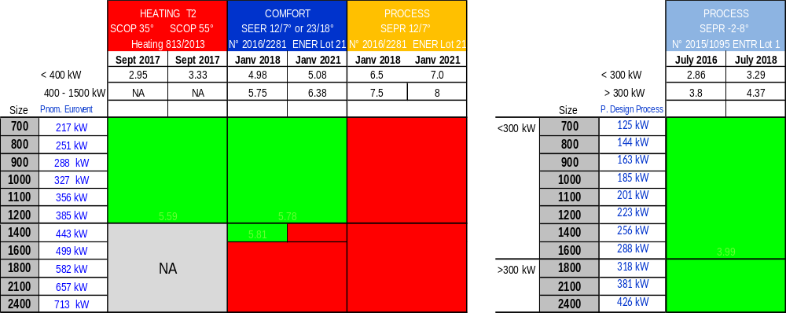

ECODESIGN COMPLIANCE
Compliance SCOP & SEPR-8°C
= Conformity = CE mark

Slide 26
AGENDA
RANGE
DESIGN
EFFICIENCY-COMPETITIVENESS
RUNNING LIMIT
SOUND LEVEL
ACCESSIBILITY-HYDRAULIC
CONTROL
OPTIONS
LGN serial

Slide 27
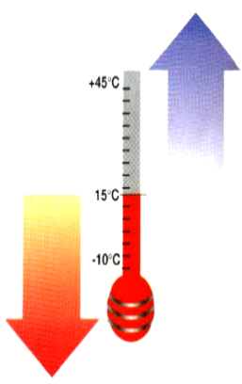
Running limit
PART LOAD OPERATION
55
FULL LOAD
45
FULL LOAD
Condenser water outlet °C
GLYCOL OBLIGATOIRE
GLYCOL WATER
PURE WATER
30
-12
-4
5
18
Evaporator water outlet °C

Slide 28
AGENDA
RANGE
DESIGN
EFFICIENCY-COMPETITIVENESS
RUNNING LIMIT
SOUND LEVEL
ACCESSIBILITY-HYDRAULIC
CONTROL
OPTIONS
LGN serial

Slide 29

Sound level
3 versions
Standard
Low Noise
Xtra Low Noise
Casing only (LN)
Casing + phonic insulation (XLN)

Slide 30
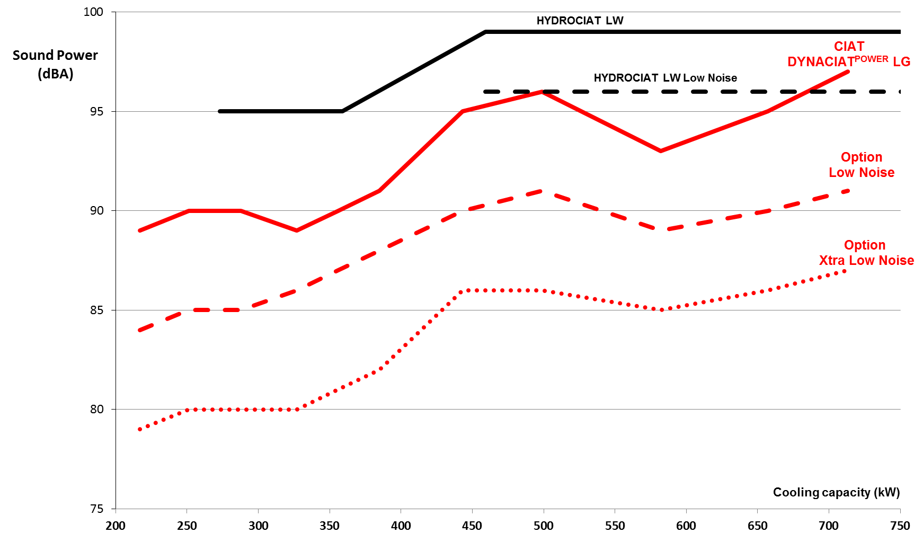
Acoustic Performance
LN = -4 dB(A)
XLN = -9 dB(A)
Standard version of DYNACIAT^{POWER} is quieter than a screw solution

Slide 31
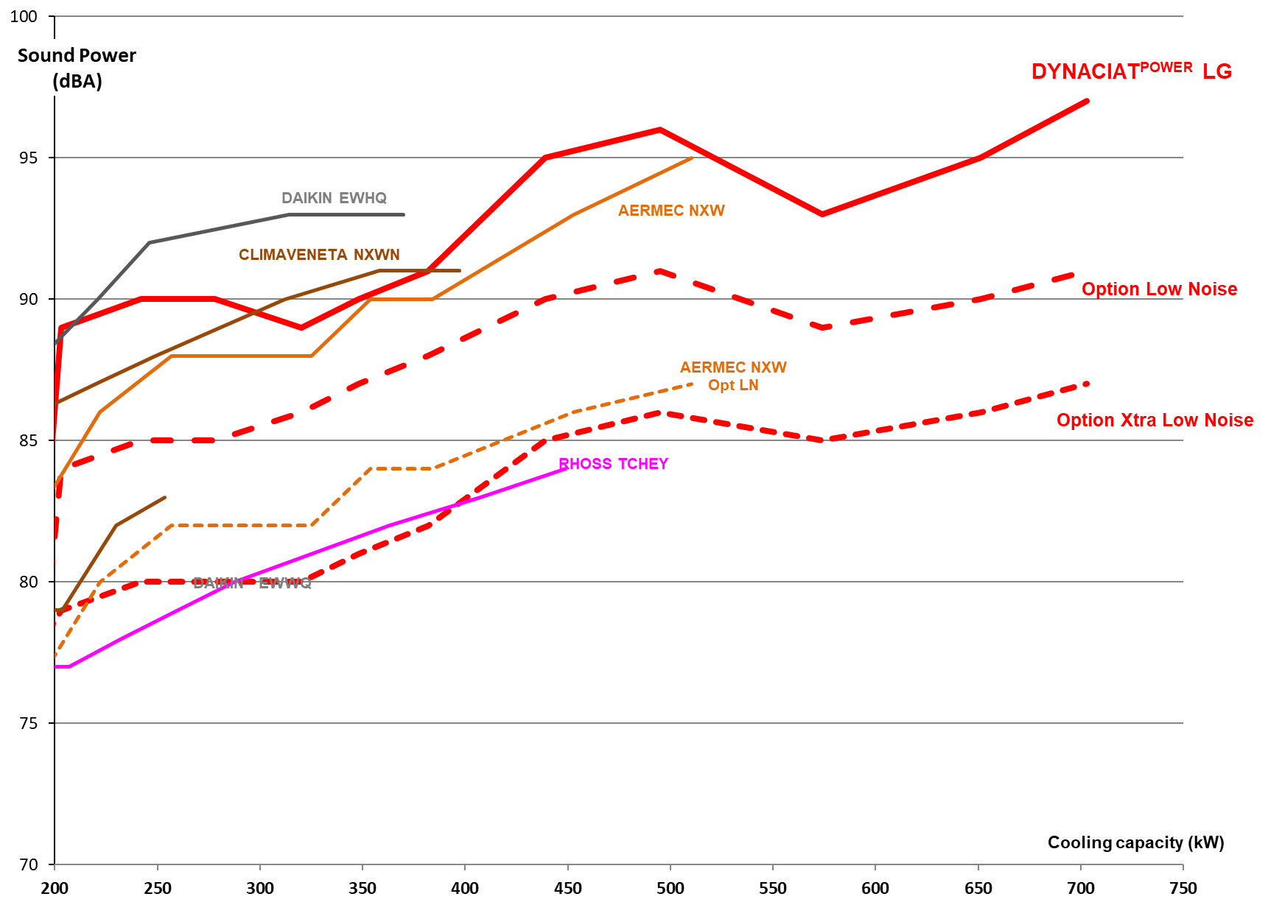
Acoustic Performance
DYNACIAT^{POWER} a quiet solution vs competition

Slide 32
AGENDA
RANGE
DESIGN
EFFICIENCY-COMPETITIVENESS
RUNNING LIMIT
SOUND LEVEL
ACCESSIBILITY-HYDRAULIC
CONTROL
OPTIONS
LGN serial

Slide 33

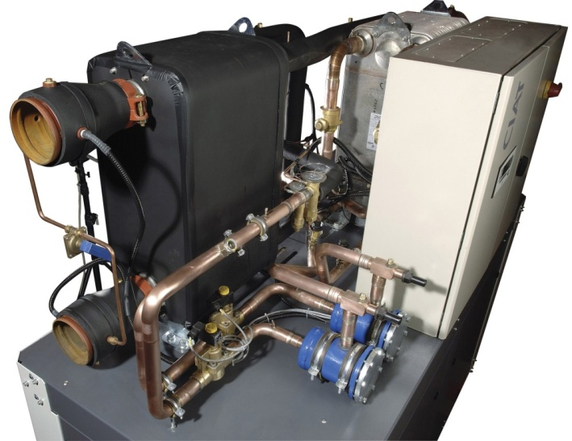
Accessibility
Exchangers
access
Sight glass, expansion valve, filter drier access
Easy access for
all the components
Easy maintenance
Electrical panel access
Compressors
access

Slide 34
Hydraulics connections
One
evaporator
One
condenser
Easy hydraulic connections

Slide 35
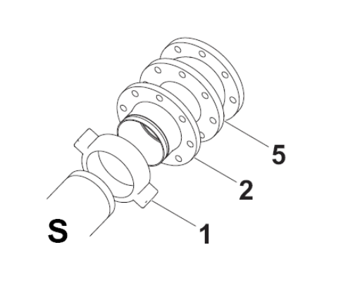
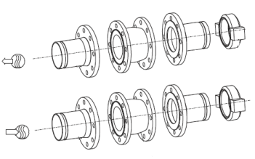
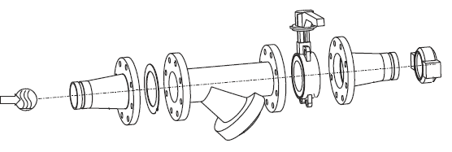
Hydraulics connections
Victaulic in standard
Victaulic-flange adapter (option)+ connection sleeve (option)
Water filter (option)
CIAT exchanger
Item | Description
1 | Victaulic clamp
2 | Flange connection
5 | Anti-vibration sleeve
Filter
1
5
2
Complete components
for easy installation

Slide 36
AGENDA
RANGE
DESIGN
EFFICIENCY-COMPETITIVENESS
RUNNING LIMIT
SOUND LEVEL
ACCESSIBILITY-HYDRAULIC
CONTROL
OPTIONS
LGN serial

Slide 37


Controller
A control for all running conditions
  Chilled water inlet or outlet control
  Control according to external temperature
  Low temperature ice storage control
  Two set points management

Slide 38
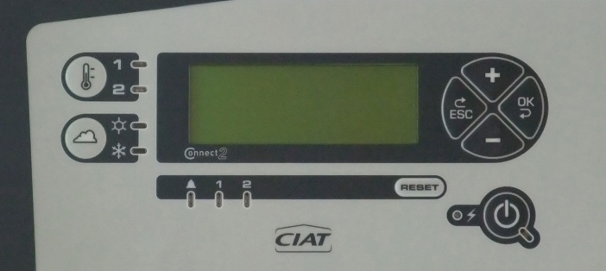
Controller
LCD 4 lines of 24 characters multilingual (F-GB-D-SP-NL-ITA-RUS)
Running and fault parameter management
Pressures and temperatures reading
Compressors starting and running time management
Compressors anti-short cycle
Pump management – Stand by function
Fault memory 20 faults memory
Master/slave function for two units
Hourly programming
Password access (3 levels)

Slide 39

Controller
Ergonomic display
LCD screen
Set point 1/2 selection
Escape
Validation
Heating/Cooling selection
On / Off
General fault
Circuit fault
Reset
Voltage indication

Slide 40
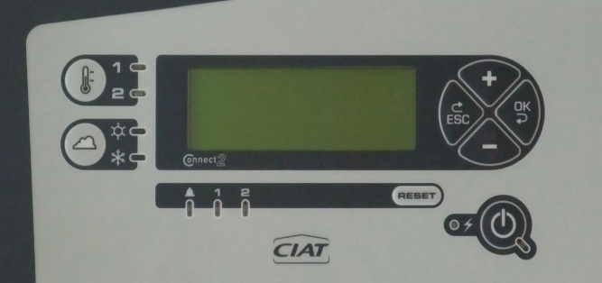
Controller
Available free voltage contacts inputs :
  Unit and pump ON/OFF contact
  Compressor load shedding
  Set point 1/2 selection
  HEATING / COOLING mode selection
  Set point control by 4-20mA SIGNAL
Available free voltage contacts outputs :
  General fault of the unit
  Pump control

Slide 41
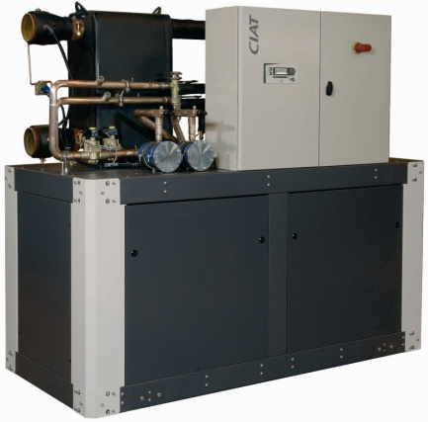
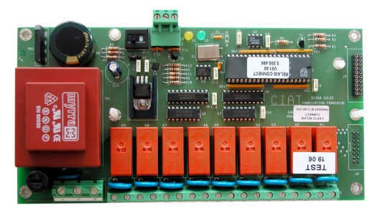
Communication
RS 485 (2 shielded wires)
1000 meters maxi
Free contact relay card
  Water flow fault
  Antifreeze fault
  HP and LP fault
  Compressors stage fault
  Fans fault (air / water unit)
  Discharge temperature fault
  Compressors stage status
230 V-1Ph-50Hz

Slide 42



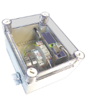



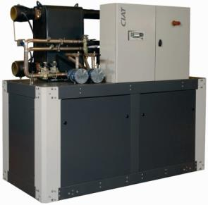
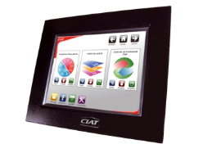
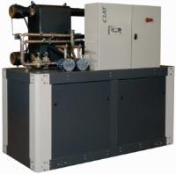
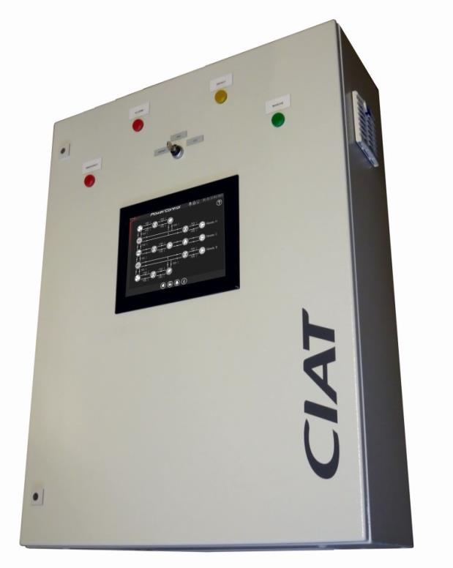

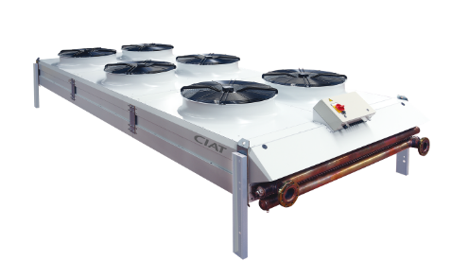

Communication
ABOUND HVAC
Performance
& Connect service
Free voltage contacts relay card (option)
Sortie RS 485 MODBUS-JBUS (standard) / MODBUS TCP – Ethernet
BACNET & LON (option)
HYSYS Easy & Smart CIATControl
POLE ENERGY Power’Control – Cristo’Control
Master/Slave

Slide 43
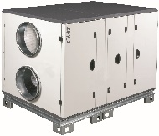
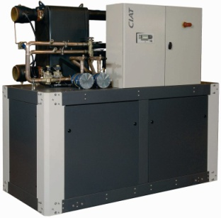







Design example with Easy CIATControl 120
Max. 4 Floways
1 chiller
Boiler
ON / OFF control
of 8 equipments
Ethernet line
Air extractor
External BMS
BACnet or OPC
Easy CIATControl 120
Max. 60 FCUs with V3000
on one KNX line
Remote access
Max. 60 FCUs with V3000
on one KNX line

Slide 44




Easy CIATControl with several energy producers
Master / Slave
function

Slide 45









CURVES
PARAMETERS
EVENTS
SYNOPTIQUE
REPORTS
INFORMATIONS
delivered as accessories by ERCD
45

Slide 46












Synoptic
Parameters
Visualize the synoptic of the installation in real time, the status of each component, the temperatures, pressures, flows, operating mode,…
Set all the parameters as easily as you are in front of the system
All parameters are order by categories for an easy use.
Trends
Information
Visualize the predefined trends or design your own trends (temperatures, pressures, modes, status,…)
See all details you need about the installation, the machine, the modem, the contract…
Events
Reports
Visualize the list of events and the context of each event (status of the installation when the fault appears)
Generate reports and visualize the efficiency of your installation, and optimize your system
Easy Service Maintenance

Slide 47




Reports
Content
Range
Added Value
Trend
Operating times
Number of compressor starts
Event reports
Preventative maintenance actions
Energy consumption (Electricity metering)
Monthly
Available on dedicated website
Actionable reports
Annual
Sent by CIAT team
Expert analysis
On demand
Sent by CIAT team

Slide 48

ABOUND HVAC Performances
Expertise and Analysis
CIAT
Expertise
Real-time
data
Energy
performance
Equipment availability
Better
profitability
Steady
indoor air quality
Added-value
services
Equipment optimal
control

Slide 49



AEROCONNECT Offre System
Users needs

Slide 50






+
RS 485 (2 shielded wires )
1000 m Maxi
Signal 0-10V
Aéroconnect
  Card integrated into the dry cooler electrical panel
  Communication between chiller and dry cooler
  Chiller + dry cooler operation optimization

Slide 51
AGENDA
RANGE
DESIGN
EFFICIENCY-COMPETITIVENESS
RUNNING LIMIT
SOUND LEVEL
ACCESSIBILITY-HYDRAULIC
CONTROL
OPTIONS
LGN serial

Slide 52
Standard equipments
Water flow switch (differential pressure switch)
Compressors mounted on anti vibration mounts
Main safety switch
Auxiliary transformer
RS485-TC/IP for BMS connection on open protocol Modbus-Jbus
Electrical panel Wiring numbering
Electrical components marking
Compressor discharge valve (1 per circuit)
Master / slave management for two units
Electronic expansion valves (sizes 1800V to 2400V)
Stand by pump function
Low temperature glycol water (-12°C)

Slide 53



Options
Low Noise and Xtra Low Noise versions
Compressor suction valve (1 per refrigerant circuit)
Anti vibration mounts
Hydraulic connection sleeves
Free contacts relay card
LON gateway
Bacnet over IP Gateway
Phases control relay
Soft start
Power & Energy counter
External sensor
Condenser insulation

Slide 54




Power counter
Power counter
Available values on
CONNECT 2 controller
Voltage on each phase (V)
Current (A)
Electrical power input (kW)
Electrical consumption (kWh)
Reduction of the electrical consumption of the unit according to maximum value

Slide 55

Soft start
Electronic device which allows to reduce the starting current on each compressor
LG 1200V
Starting current
Direct on line
480 A
With Soft Start
352 A
-25%

Slide 56



Phases control relay
Relay mounted on the main power supply of the unit for the surveillance of the electricity network and safety of the unit
Phases rotation direction
no phase
Asymmetry of phases
under and over voltage control

Slide 57
AGENDA
RANGE
DESIGN
EFFICIENCY-COMPETITIVENESS
RUNNING LIMIT
SOUND LEVEL
ACCESSIBILITY-HYDRAULIC
CONTROL
OPTIONS
LGN serial

Slide 58




Quality
Compliance :
To European regulations
Guaranty :
Performances certified EUROVENT
Quality :
Design and manufacture as per ISO 9000-14000 quality management system

Slide 59





11 sizes
220 à 700 kW
250 à 820 kW
Compactness
Easy maintenance
High efficiency
ESEER > 6
All
applications
-12°C / +18°C
Heat pump
operation
up to +55°C
3 acoustic
design
STD-LN-XLN

