Slide 1


Using renewable energies for air conditioning, domestic hot water and heating

Slide 2

expertise in hospitality applications
With over 80 years' experience in climatic engineering, we build our expertise on a close relationship with our customers.
We have consolidated our experience in the hotel trade into an extremely rich database. Using the textbook cases in it, we work together with you to find the best solutions for your particular project.

Slide 3

expertise in hospitality applications
Comfort
CIAT is recognized for the acoustic, thermal and air quality of the indoor environments created to ensure comfort of your customers.
Energy optimization
We develop energy efficient solutions allowing substantial savings to be made without compromising on your customers’ comfort.
With comfort and energy optimization in mind, we provide global solutions with a low carbon footprint that go beyond the simple notion of kW/h consumed and energy savings.

Slide 4

Guiding you right from the start
With a team of hospitality experts eager to help you, CIAT is your partner in your success. We work with you right from the design phase to analyse your specific requirements and offer you solutions to optimise your hotel’s air conditioning, heating and hot-water production capacities.

Slide 5
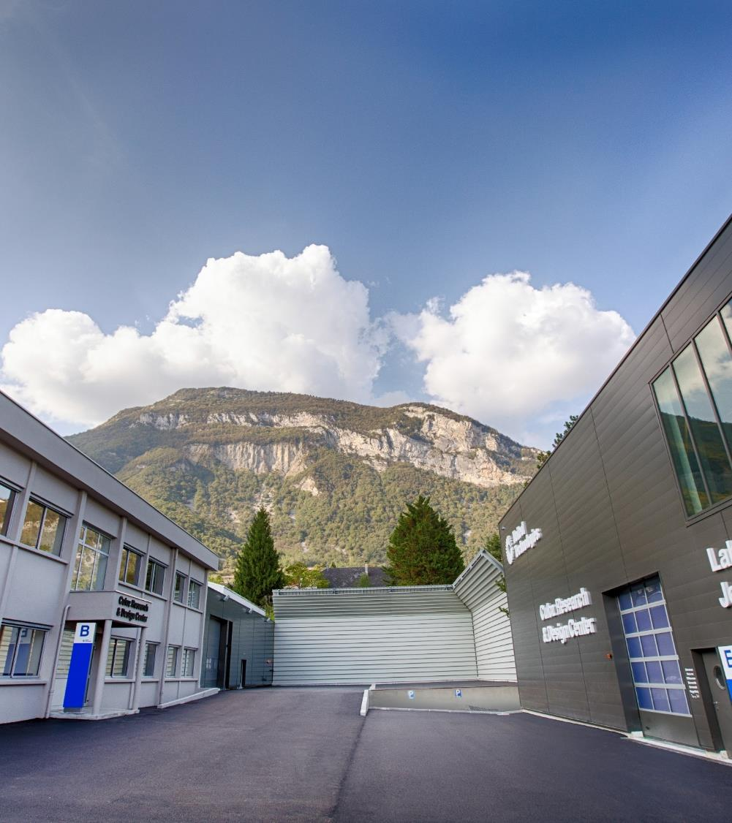
world-class AIRSIDE facilities
Airside expertise
Our Research and Design Center and Laboratory has seven innovation platforms, equipped with state-of-the-art test and measurement tools, fully dedicated to airside applications.
Teams at this 3000m² facility in eastern France carry out prototyping and testing for our development teams and ultimately for our customers, who are looking for the best in innovation.
Industrial Excellence
The skills and expertise of our teams are backed by completely integrated powerful production facilities resulting in a fully-mastered industrial procedure.
Our manufacturing sites are certified with ISO 9001,
ISO 14000 and OSHAS 8001.
Notes:
In order to register buildings with the highest environmental labels (according to LEED, BREEAM, HQE or DGNB), CIAT develops highly environmental efficient systems that go over and above the standards in force. These solutions are based on three fundamentals:
Hygiene & Air quality
Knowledge of microbiological pollutants, chemical particles and air is fundamental to guarantee maximum hygiene. Our solutions meet the hygiene norms (EN 13779, EN 15251, NFS 90 351, ISO 14644, ISO 14698…). With innovations such as the EPURE function or NEO Bio, CIAT goes further to eliminate pollution and contamination.
Comfort
CIAT is recognised for the quality of the indoor environments created. Derived from the Coadis range, the European reference, the Coadis Medical Comfort unit ensures the highest level of performance conforming to ISO 7730.
Energy optimization
Energy performance is not a purpose in itself, but combined with expertise in air quality, comfort, hygiene and intelligent design, it is a significant source of energy savings. By combining the most efficient and innovative products, CIAT Medical System can offer the best energy configuration and anticipate the requirements of future Thermal Regulations.
Guiding you right from the start
To ensure you are provided with the right solutions, the CIAT Healthcare Experts, in your area, will work alongside you from conception and throughout the implementation of your project. They will analyse your specifications, and thanks to their expertise and specific software designed by our engineers, will provide you with the optimum solution to meet your requirements.
CIAT services bring lasting confidence
CIAT equipment will constantly give you the very best compromise between energy performance, hygiene and comfort, now and for the future. It is with this aim in mind that we have developed a range of service contracts: preventive and curative maintenance and renewed repair contracts.
A CIAT Healthcare exclusive:
the Comfort Unit test chamber At the heart of our Centre for Research and Innovation, the Comfort Unit, in addition to the computer-generated models, is an important base for tests in real conditions. Depending on the equipment selected and the options retained, we can perform a simulation in 1:1 scale according to ISO 7730 and in this way guarantee the comfort levels of your individual project.

Slide 6


Your CHALLENGES
CUSTOMERS’ SATISFACTION
Thermal comfort
Acoustic comfort
Indoor air quality

Slide 7

Your CHALLENGES
PEACE OF MIND
Guaranteed maintenance and operation
CIAT Services: ensuring quality and continual comfort

Slide 8

Your CHALLENGES
Energy optimisation
Energy savings
Installation, commissioning
and maintenance cost reduction

Slide 9

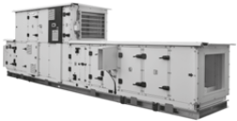
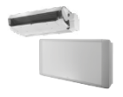
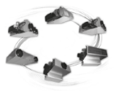
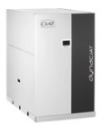
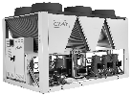
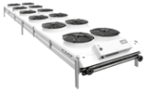

Tailor-made solutions for all your challenges
Customers’ comfort
Energy optimisation
CLIMACIAT AIRACCESS
Accessible and efficient air handling unit that is simple
to install and use.
MAJOR
LINE
Versatile and highly efficient comfort unit providing improved comfort and very low
sound level.
COMFORT LINE
Comfort unit with high available static pressure, modular air discharge configurations, flexible installation and excellent acoustic comfort.
DYNACIAT
Compact and silent high energy efficiency Scroll
compressors.
High-efficiency brazed plate heat exchangers.
Self-adjusting electronic control.
Heat recovery option for domestic hot water production.
OPERA
Drycooler range
compatible with
Dynaciat range for
favourable all-round
performance levels.
AQUACIAT & AQUACIAT^{POWER}
High efficiency air-cooled chiller and heat pump with
scroll compressor and heat recovery option for domestic hot water production.

Slide 10
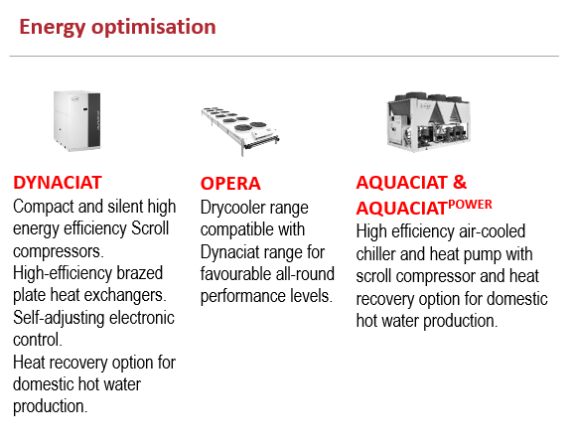
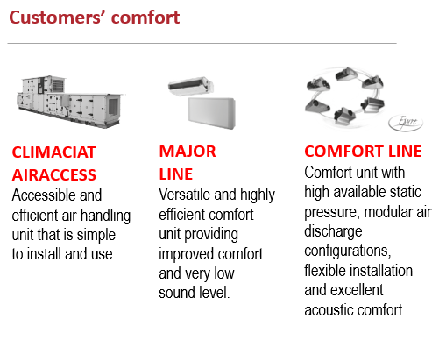
Tailor-made solutions for all your challenges

Slide 11
AQUACIAT & AQUACIAT^{POWER} with R-32

Slide 12

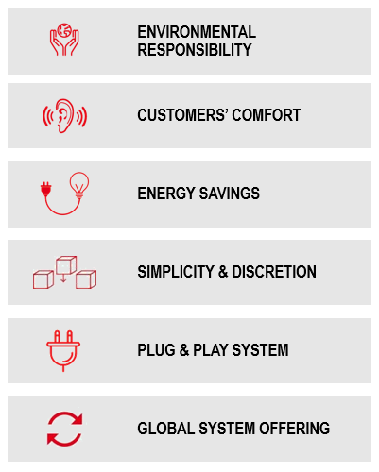
AQUACIAT & AQUACIAT^{POWER} with R-32
Perfectly suited for hospitality applications

Slide 13


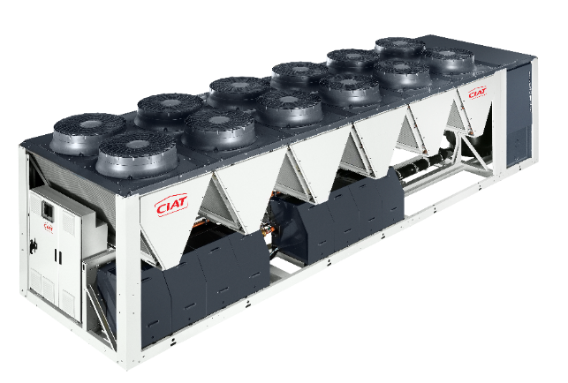
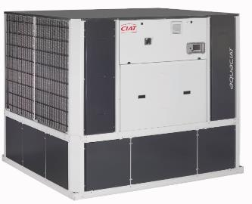
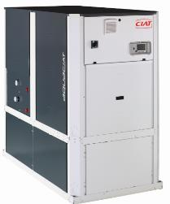
Now available with
R-32 refrigerant
      The AQUACIAT & AQUACIAT^{POWER} range is now available with R-32 refrigerant for a lower ecological footprint, up to 77% less carbon footprint, while improving even further it’s energy performances +10% and preserving its acoustic level and its installation simplicity.

Slide 14


AQUACIAT Range overview
CHILLER COOLING ONLY LD
HEAT PUMP ILD
40 kW
160 kW
Variable speed Drive or EC fans motors option
All seasons, All climates, All applications options
Fixed speed scroll compressors, AC fans

Slide 15
AQUACIAT^{Power} Range overview
CHILLER COOLING ONLY LD
170 kW
400 kW
940 kW
EC fans motors option ( Seasonal performances)
Variable speed fans option ( Seasonal performances)
High performance option / High temperature: High speed fans ( Nominal performances & Operating map)
Fixed speed scroll compressors, AC fans-low speed
HEAT PUMP ILD
170 kW
530 kW
1040 kW
EC fans motors option ( Seasonal performances)
Variable-speed AC motor fans option
+ drive (  Seasonal performance levels)
High performance option / High temperature: High speed fans
( Nominal performances & Operating map)
Fixed speed scroll compressors, AC fans motors-low speed
Fixed-speed scroll compressors,variable-speed AC motors fans + Drive

Slide 16
R-32, The BEST refrigerant solution FOR SCROLL CHILLERs

Slide 17
EU F-gas regulation
HFC Phase down
2018
2024
2030
-37%*
-69%*
-79%*
Note: EU F-Gas Regulation No. 517/2014
*Versus 2015 reference value

Slide 18
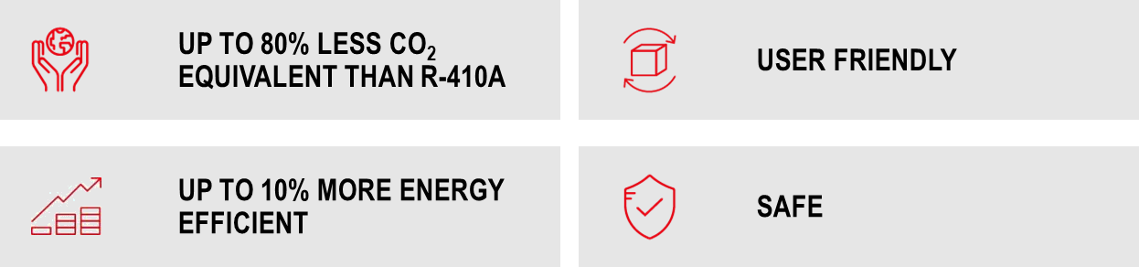

Why r-32?

Slide 19
ENVIRONMENTALLY responsible
LOWER GWP
-68%
Refrigerant global warming potential (GWP) reduction:
Lower ecological impact
Anticipating the HFC phase-down
R-410A GWP = 2088
R-32
GWP = 675
Note: GWP according to IPCC AR4

Slide 20
ENVIRONMENTALLY responsible
REFRIGERANT CHARGE REDUCTION
-30%
Refrigerant charge reduction due to:
R-32 thermodynamic properties
Optimized component selection for R-32
Aquaciat^{power} R-410A
Aquaciat^{power} R-32

Slide 21
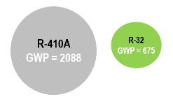
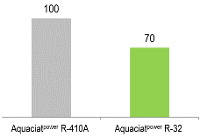

ENVIRONMENTALLY responsible
-68%
GWP
-30%
Refrigerant charge
&
77% less CO₂ equivalent
than R-410A

Slide 22

Energy seasonal efficiency
+ 10%
SEER
Up to
5,33
+10%
Aquaciat & Aquaciat^{power} with R-32 chillers exceed Ecodesign 2021 SEER requirements due to:
Multiple scroll compressors
Asymmetric brazed plate heat exchangers
Smart energy monitoring function
Aquaciat^{power} R-410A
Aquaciat^{power} R-32
Note: ErP Ready 2021 according to EU Regulation No. 2016/2281

Slide 23
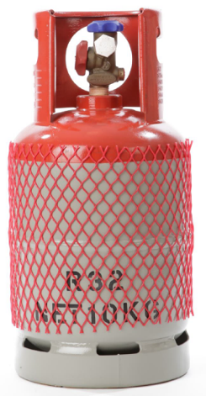
User friendliness
R-32 is a tried and trusted solution already used in residential air conditioners (millions AC in use.)
Easy refrigerant charge complement
It is available from all refrigerant distributors in cylinders of 5, 10, 20 or 45 kg with top in red color.

Slide 24
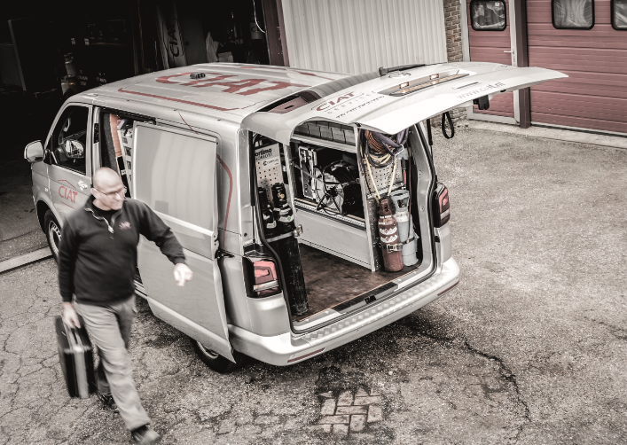
Safety
Service tools must be qualified for A2L refrigerants according to ISO 817 or EN378
Service engineers shall be qualified for brazing of components containing PED fluid group 2
Specific safety rules for compliance with UN3358 for road transportation and DS291 IMDG for sea shipping:
- Road transportation:
- UN code: 3358 REFRIGERATING MACHINES containing flammable, non-toxic, liquified gas
- Road tunnels class D & E not allowed
- Sea transportation:
- International Maritime Dangerous Goods (IMDG) code: DS 291
- Air transportation:
- Not allowed

Slide 25
AQUACIAT & AQUACIAT^{POWER} with R-32
Perfectly suited for hospitality applications

Slide 26
AQUACIAT & AQUACIAT^{POWER} with R-32
Perfectly suited for hospitality applications

Slide 27


AQUACIAT & AQUACIAT^{POWER} with R-32
ENVIRONMENTAL RESPONSIBILITY
  We strive to conform to your highest environmental commitments.
  We concentrate our efforts on making our units more efficient and more environmentally friendly.
  Aquaciat and Aquaciat^{power} with R-32 goes beyond 2021 Ecodesign requirements.
  Product Life cycle assessment is certified with a Product Environmental Profile (PEP) performed following PEP ecopassport® criteria, following ISO 1402 international standard. Environmental analysis shall consider product manufacturing, distribution, installation and end of life. PEP document is published on www.pep-ecopassport.org.
SEER
Up to
5,33
SCOP
Up to
4,00

Slide 28

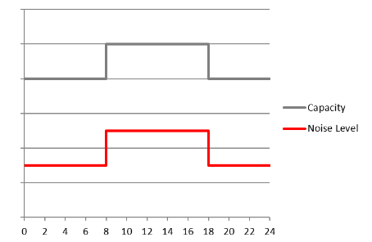






AQUACIAT & AQUACIAT^{POWER} with R-32
customers’ comfort
We take care of your customers’ acoustic comfort.
Thanks to low-speed fans in standard & the noise-reduction technologies used in the new Aquaciat and Aquaciat^{power} ranges, you can guarantee a low noise level and no vibrations.
Optional variable-speed fans allow noise reduction in part load operation (night, mid-season…).
VERY LOW NOISE
-3 to -4 dB(A)
thanks to the compressor enclosure
ULTRA LOW NOISE
-5 to -6 dB(A)
thanks to specific insulation on compressor enclosure and unit’s panels
XTRA LOW NOISE
-9 dB(A)
thanks to specific insulation on compressor enclosure
NIGHT MODE
noise reduction
in part load operation
aquaciat^{power}
aquaciat^{power}
aquaciat

Slide 29


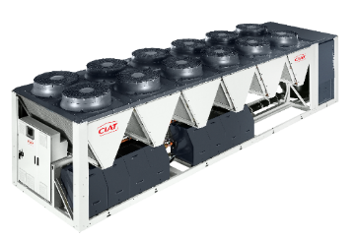


AQUACIAT & AQUACIAT^{POWER} with R-32
Energy savings
We develop energy efficient solutions allowing substantial savings to be made without compromising on your customers’ comfort nor your environmental impact.
The recovery of the partial heating capacity supplied by the chiller enables the unit to produce free additional hot water up to 80°C. This free heat is used for domestic hot water or distributed to spaces where it is needed, such as swimming pools, spas and whirlpool baths.
100% Chilled or Hot Water Production
30%
energy
25% Domestic Hot Water Production
or
100% Domestic Hot Water Production

Slide 30

AQUACIAT & AQUACIAT^{POWER} with R-32
Simplicity & discretion
We ensure easy installation and space savings for the complete peace of mind of your technical teams:
  No technical room required to house pumps and other accessories.
  Optimum use of the surface area for easy integration into an existing building.
Quick, easy and cost-effective installation and commissioning.
Packaged solution, which saves you time and increases your installation’s reliability.
The components in the hydraulic system are carefully selected, factory assembled and tested, limiting risks and facilitating installation on site.

Slide 31

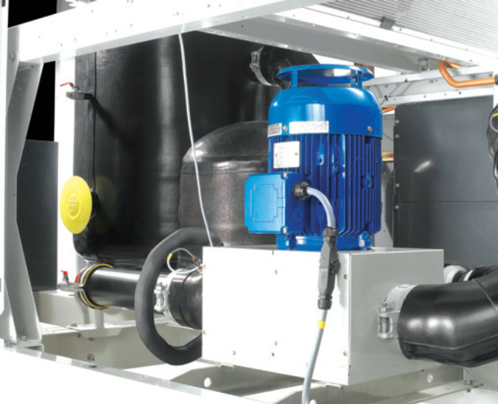
Aquaciat & AQUACIAT^{POWER} with R-32
Plug and play system
  We provide all-in-one yet flexible solution.
  With the Aquaciat and the Aquaciat^{power} ranges you can choose among a variety
  of versions:
  Integrated hydraulic module with or without buffer tank.
  Wide choice of pumps
  A wide selection of hydraulic couplings to fit site configuration.

Slide 32

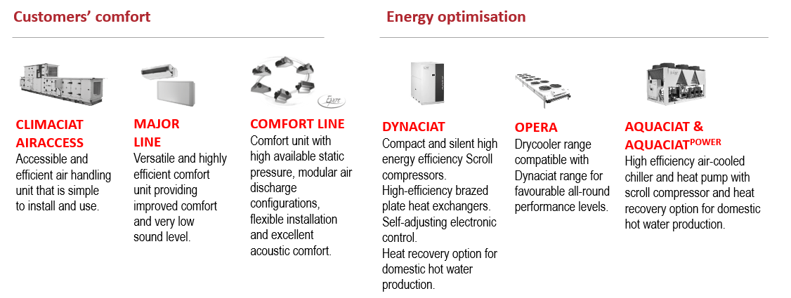
AQUACIAT & AQUACIAT^{POWER} with R-32
Global system offering
We offer a complete range of equipment designed to work together for the best possible results providing optimised energy efficiency and comfort for your customers.

Slide 33
A COMBINATION OF TECHNOLOGIES

Slide 34
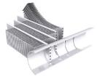


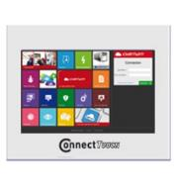


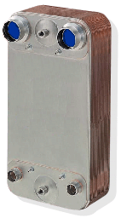

A COMBINATION OF TECHNOLOGIES
Fixed-speed fans (standard)
Variable speed fans
(Drive or EC option)
MCHE condenser coil LD
RTPF coil heat-pump ILD
Connect Touch control
Buffer tank module
Variable speed pump (option)
Optimized
Fixed-speed scroll compressors
Brazed plate
heat exchanger
Electronic expansion valve

Slide 35
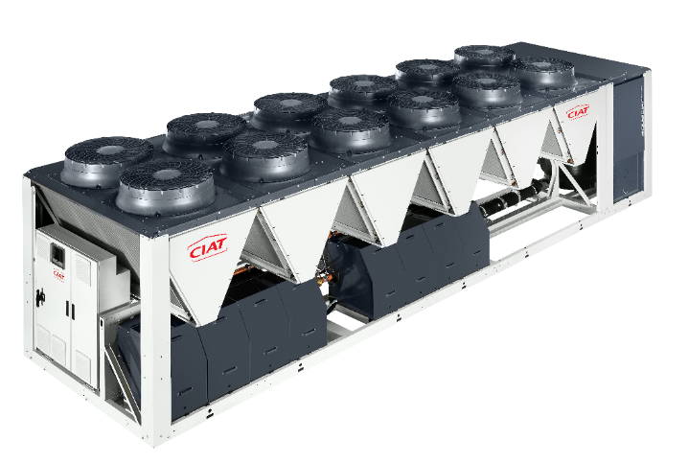

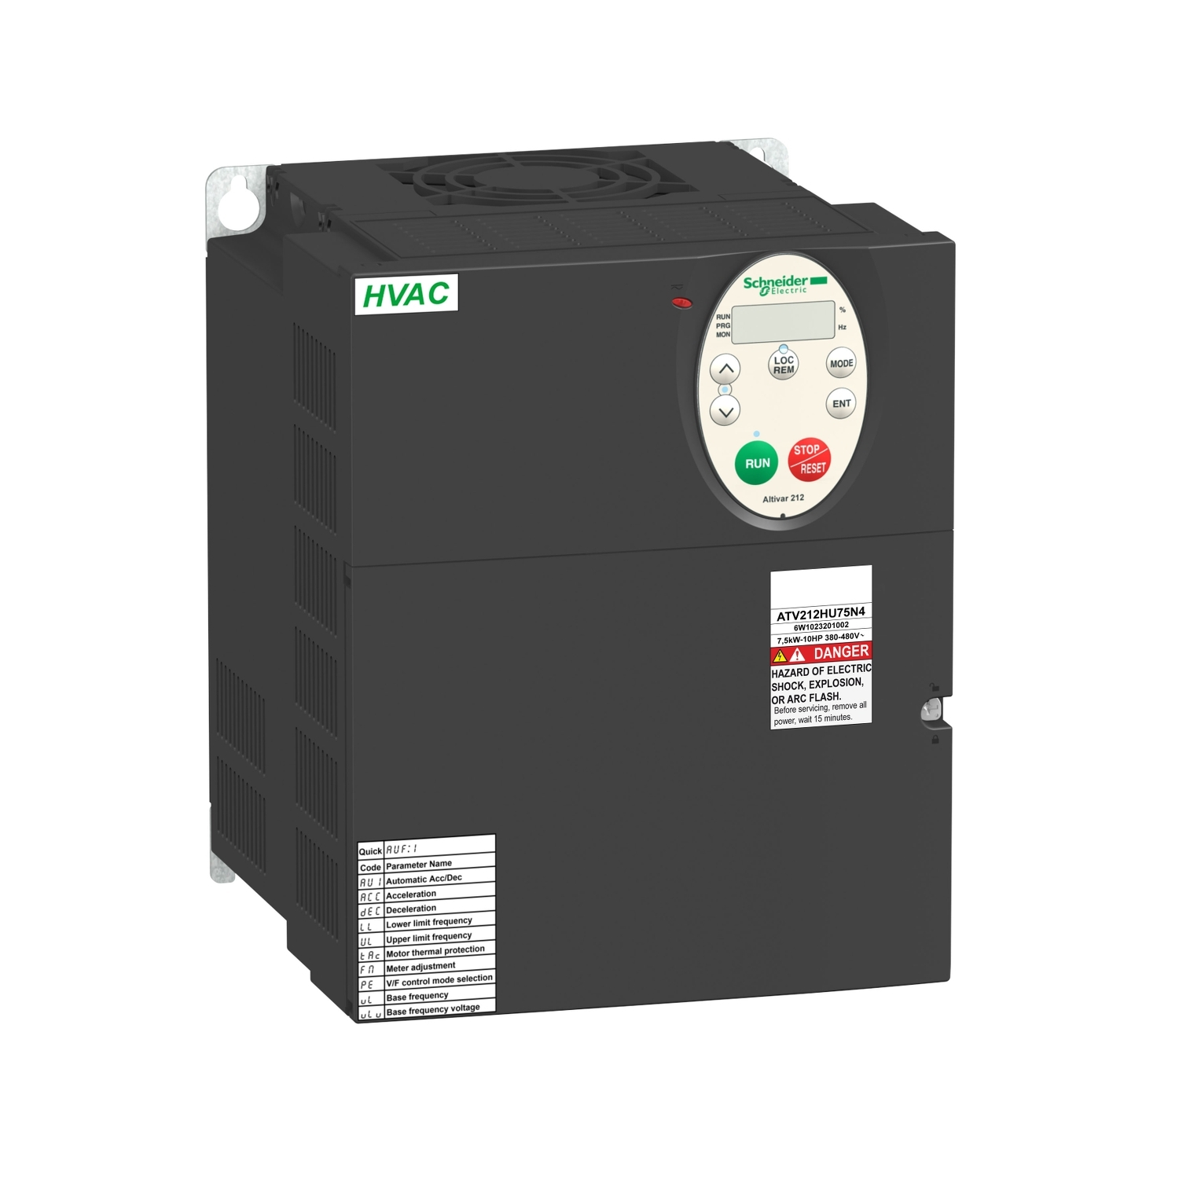
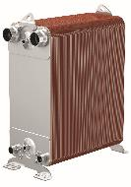
A COMBINATION OF TECHNOLOGIES
Fixed-speed fans (standard)
Variable speed fans
(Drive or EC option)
Composite fan stacks
MCHE condenser coil LD
RTPF coil heat-pump ILD
Buffer tank module
Connect Touch control
Variable speed pump (option)
Optimized
scroll compressors
Asymmetric brazed plate
heat exchanger
Electronic expansion valve

Slide 36
MAXIMUM EFFICIENCY

Slide 37
MAXIMUM EFFICIENCY
Case study
Annual Energy Cost
Application:
Air conditioning
Capacity: 300kW
Running conditions: 12/7°C/35°C
Operating: unit 1800 h/year – pump 4300h/year
Unit R410A: AQP LD HE 1100 + HP pump
Unit R-32: AQP LD 1200R + Opt High Performance + Pump HP
Electricity cost: 0.07€/kWh
Simulation on BencHVAC Tools
- 7%
Annual unit energetic cost
Total Cost of Ownership
Payback
< 3 years
Device cost installed: R410A: 45000€ / R-32: 47500€ (+5%)
Maintenance contract cost: R410A = R-32 = 2200€/year
Cost of repair: R410A: 1800€/year / R-32: 1000€/year
(difference due to refrigerant taxes)
Gain €13k in 15 years
Source: Estimates based on CIAT calculations

Slide 38


MAXIMUM EFFICIENCY
Cooling only versions
AQUACIAT^{POWER} LD
 | 0602R | 0650R | 0750R | 0900R | 1100R | 1200R | 1350R | 1400R | 1600R | 1750R | 1800R | 2000R | 2200R | 2400R | 2650R | 2800R | 2950R | 3200R | 3500R
UNIT + OPT HIGH NOMINAL & SEASONAL EFFICIENCY
NOMINAL CAPACITY * _{CA1} KW | 172 | 187 | 206 | 227 | 270 | 311 | 346 | 380 | 416 | 451 | 484 | 553 | 616 | 677 | 726 | 782 | 807 | 882 | 944
EER* KW/KW | 3,20 | 3,36 | 3,21 | 3,16 | 3,03 | 3,15 | 3,09 | 3,14 | 3,10 | 3,15 | 3,09 | 3,08 | 3,16 | 3,14 | 3,06 | 3,07 | 3,04 | 3,00 | 2,92
SEER 12/7°C COMFORT LOW TEMP. KWH/KWH | 4,82 | 5,02 | 4,84 | 4,94 | 4,79 | 5,25 | 5,15 | 5,09 | 5,11 | 5,28 | 5,24 | 5,29 | 5,32 | 5,32 | 5,20 | 5,33 | 5,30 | 5,31 | 5,18
SEER 23/18°C COMFORT MEDIUM TEMP. KWH/KWH | 5,98 | 6,23 | 5,93 | 5,99 | 5,69 | 6,35 | 6,17 | 6,13 | 6,07 | 6,33 | 6,23 | 6,32 | 6,56 | 6,51 | 6,28 | 6,54 | 6,47 | 6,56 | 6,32
SEPR -2/-8°C PROCESS MEDIUM TEMP. KWH/KWH | 3,48 | 3,60 | 3,54 | 3,41 | 3,41 | 3,51 | 3,56 | 3,50 | 3,57 | 3,55 | 3,55 | 3,55 | 3,91 | 3,82 | 3,83 | 3,79 | 3,80 | 3,74 | 3,74
Eurovent certified values
*In accordance with standard EN14511-3:2018.
CA1 Cooling mode conditions: Evaporator water entering/leaving temperature 12°C/7°C, outside air temperature 35°C, evaporator fooling factor 0 m².K/W
SEER 12/7°C Values in bold comply with Ecodesign Regulation (EU) No. 2016/2281 for Comfort applications
SEER 23/18°C Values in bold comply with Ecodesign Regulation (EU) No. 2016/2281 for Comfort applications
SEPR -2/-8°C Applicable Ecodesign regulation: (EU) No 2015/1095.
10/07/2023

Slide 39
MAXIMUM EFFICIENCY
Cooling only versions
AQUACIAT^{POWER} LD
 | 0602R | 0650R | 0750R | 0900R | 1100R | 1200R | 1350R | 1400R | 1600R | 1750R | 1800R | 2000R | 2200R | 2400R | 2650R | 2800R | 2950R | 3200R | 3500R
SOUND POWER LEVELS ** STANDARD UNIT UNIT + OPTION HIGH OAT / HIGH NOMINAL PERFORMANCES UNIT + OPTION VERY LOW NOISE dB(A) UNIT + OPTION ULTRA LOW NOISE dB(A)
 | 88,5 91,0 85,5 83,5 | 89,0 91,5 85,5 83,5 | 89,0 91,5 85,5 83,5 | 89,5 92,0 86,5 84,5 | 89,5 92,0 86,5 84,5 | 90,5 93,0 87,5 85,5 | 90,5 93,0 87,5 85,5 | 91,0 93,5 88,0 86,0 | 91,0 93,5 88,0 86,0 | 91,5 94,0 88,5 86,5 | 91,5 94,0 88,5 86,5 | 92,0 94,5 89,0 87,0 | 96,5 97,5 92,5 90,0 | 96,5 97,5 92,5 90,0 | 97,0 98,0 93,0 90,5 | 97,0 98,0 93,0 90,5 | 97,5 98,5 93,5 90,5 | 97,5 98,5 93,5 90,5 | 98,0 99,0 94,5 91,0
STANDARD UNIT LENGTH - WIDTH - HEIGHT mm
 | 2410 2253 2324 | 2410 2253 2324 | 2410 2253 2324 | 2410 2253 2324 | 2410 2253 2324 | 3604 2253 2324 | 3604 2253 2324 | 3604 2253 2324 | 3604 2253 2324 | 4798 2253 2324 | 4798 2253 2324 | 4798 2253 2324 | 5992 2253 2324 | 5992 2253 2324 | 5992 2253 2324 | 7186 2253 2324 | 7186 2253 2324 | 7186 2253 2324 | 7186 2253 2324
REFRIGERANT*** | R32 / A2L / GWP=675 following AR4
Eurovent certified values
** In dB ref=10⁻¹² W, 'A' weighted. Declared dual-number noise emission values in accordance with ISO 4871 with an associated uncertainty of +/-3dB(A). Measured in accordance with ISO 9614-1 and certified by Eurovent.
*** Values are guidelines only. Refer to the unit name plate.
10/07/2023

Slide 40

MAXIMUM EFFICIENCY
Heat pump versions
AQUACIAT^{POWER} ILD
 | 0602R | 0700R | 0800R | 0900R | 1000R | 1150R | 1250R | 1400R | 1500R | 1600R | 1750R | 2000R | 2300R | 2500R | 2800R | 3000R | 3200R | 3500R | 4000R
HEATING UNIT + OPT HIGH NOMINAL & SEASONAL EFFICIENCY
NOMINAL CAPACITY * _{HA1} KW | 178 | 197 | 237 | 256 | 275 | 317 | 336 | 387 | 406 | 441 | 467 | 537 | 635 | 673 | 774 | 812 | 883 | 935 | 1075
COP* KW/KW | 3,88 | 3,80 | 3,84 | 3,84 | 3,82 | 3,82 | 3,81 | 3,82 | 3,81 | 3,80 | 3,73 | 3,80 | 3,82 | 3,81 | 3,82 | 3,81 | 3,80 | 3,73 | 3,80
SCOP30/35°C KWH/KWH | 3,67 | 3,66 | 3,74 | 3,77 | 3,80 | 3,87 | 3,86 | 3,90 | 3,91 | 3,92 | 3,89 | 3,96 | 3,87 | 3,86 | 3,90 | 3,91 | 3,92 | 3,89 | 3,96
COOLING UNIT + OPT HIGH NOMINAL & SEASONAL EFFICIENCY
NOMINAL CAPACITY * _{CA1} KW | 164 | 181 | 215 | 236 | 254 | 302 | 324 | 362 | 381 | 413 | 439 | 500 | 604 | 648 | 723 | 761 | 825 | 878 | 999
EER* KW/KW | 2,92 | 2,78 | 2,91 | 2,85 | 2,76 | 2,85 | 2,80 | 2,82 | 2,76 | 2,81 | 2,74 | 2,73 | 2,85 | 2,80 | 2,82 | 2,76 | 2,81 | 2,74 | 2,73
SEER 12/7°C COMFORT LOW TEMP. KWH/KWH | 4,44 | 4,26 | 4,53 | 4,44 | 4,34 | 4,77 | 4,81 | 4,88 | 4,87 | 4,81 | 4,75 | 4,81 | 4,77 | 4,81 | 4,88 | 4,87 | 4,81 | 4,75 | 4,81
Eurovent certified values
*In accordance with standard EN14511-3:2018.
HA1 Heating mode conditions: Water heat exchanger water entering/leaving temperature 30°C/35°C, outside air temperature tdb/twb = 7°C db/6°C wb, evaporator fooling factor 0 m².K/W
CA1Cooling mode conditions: Evaporator water entering/leaving temperature 12°C/7°C, outside air temperature 35°C, evaporator fooling factor 0 m².K/W
SCOP 30/35°C Bold values compliant to Ecodesign regulation: (EU) No 813/2013 for Heat Pump application
SEER 12/7°C Applicable Ecodesign regulation: (EU) No 2016/2281
10/07/2023

Slide 41
MAXIMUM EFFICIENCY
Heat pump versions
AQUACIAT^{POWER} ILD
 | 0602R | 0700R | 0800R | 0900R | 1000R | 1150R | 1250R | 1400R | 1500R | 1600R | 1750R | 2000R | 2300R | 2500R | 2800R | 3000R | 3200R | 3500R | 4000R
SOUND POWER LEVELS ** STANDARD UNIT UNIT + OPTION HIGH OAT / HIGH NOMINAL PERFORMANCES UNIT + OPTION VERY LOW NOISE dB(A) UNIT + OPTION ULTRA LOW NOISE dB(A)
 | 88,0 90,5 85,0 83,0 | 88,5 91,0 86,0 84,0 | 89,0 91,5 86,5 84,5 | 89,5 92,0 87,0 85,0 | 89,5 92,0 87,0 85,0 | 90,5 93,0 88,0 86,0 | 91,0 93,5 88,0 86,0 | 91,5 94,0 89,0 86,5 | 91,5 94,0 89,0 87,0 | 92,0 94,5 89,5 87,5 | 92,5 94,5 90,0 87,5 | 93,0 95,0 90,0 88,0 | 93,5 96,0 91,0 89,0 | 94,0 96,5 91,0 89,0 | 94,5 97,0 92,0 89,5 | 94,5 97,0 92,0 90,0 | 95,0 97,5 92,5 90,5 | 95,5 97,5 93,0 90,5 | 96,0 98,0 93,0 91,0
STANDARD UNIT LENGTH - WIDTH - HEIGHT mm
 | 2410 2253 2324 | 2410 2253 2324 | 2410 2253 2324 | 2410 2253 2324 | 2410 2253 2324 | 3604 2253 2324 | 3604 2253 2324 | 3604 2253 2324 | 3604 2253 2324 | 4798 2253 2324 | 4798 2253 2324 | 4798 2253 2324 | 7708 2253 2324 | 7708 2253 2324 | 7708 2253 2324 | 7708 2253 2324 | 10096 2253 2324 | 10096 2253 2324 | 10096 2253 2324
REFRIGERANT*** | R32 / A2L / GWP=675 following AR4
Eurovent certified values
** In dB ref=10⁻¹² W, 'A' weighted. Declared dual-number noise emission values in accordance with ISO 4871 with an associated uncertainty of +/-3dB(A). Measured in accordance with ISO 9614-1 and certified by Eurovent.
*** Values are guidelines only. Refer to the unit name plate.
10/07/2023

Slide 42
FEATURES AVAILABILITY
AQUACIAT & AQUACIAT^{power}
4’’3 user-friendly touch screen |  | Compressors Soft starter | ❐
Multi-language controller |  | Hydraulic pump high/Low pressure Single/twin Fixe/Variable speed | ❐
Energy consumption measurement | ❐ | Water buffer tank | ❐
WEB connectivity |  | Flanged connexion | ❐
Modbus BMS connectivity |  | Flexible connexion | ❐
Lon / Bacnet protocol BMS connectivity | ❐ | Antivibratil mounts | ❐
BluEdge monitoring | ❐ | Ultra Fast capacity recovery | ❐
Acoustic options | ❐ | IT Neutral | ❐
Variable speed fans (Drive or EC solutions) | ❐ | Phase Control | ❐
All year round operations | ❐ | CEM C2 Class | ❐
Partial or total free cooling with or without glycol | ❐
Partial or total heat recovery | ❐
Coil Anti-corosion protection | ❐ | Supplied as standard | 
Anti-Intrusion Coil protective grille | ❐ | Option | ❐

Slide 43
BLUEDGE® SERVICE PLATFORM

Slide 44
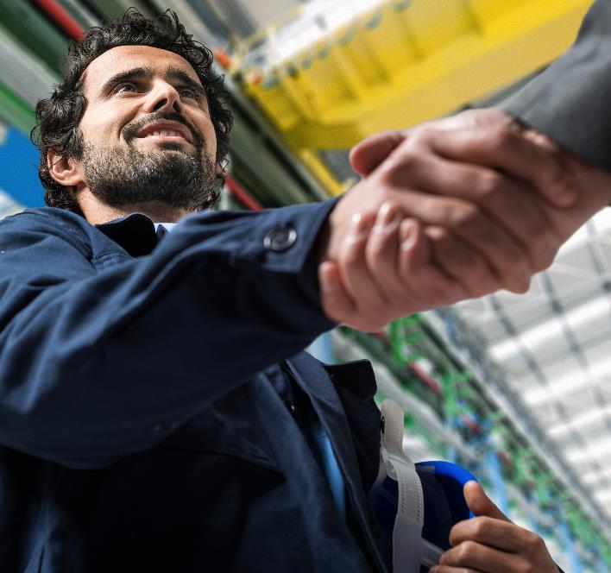
HVAC EXPERTS CLOSE AT HAND
      A COMBINATION OF KNOWLEDGE AND EXPERIENCE FOR BETTER TECHNICAL SUPPORT
    Our qualified and responsive BluEdge teams of technicians are available to implement actions on site and ensure optimal operation of your equipment. Thanks to our expertise and experience in the fields of maintenance and technical service, our BluEdge service platform offers a wide range of services from pre-sales technical support and diagnostics right through to energy audits.
    Our dedicated hotline for off-site support with our engineers and technicians on the field, work hand in hand to meet your expectations in terms of energy efficiency. Our priority, 24/7: to allow you to focus on your business whilst our BluEdge service platform provides you with the best possible level of service.

Slide 45

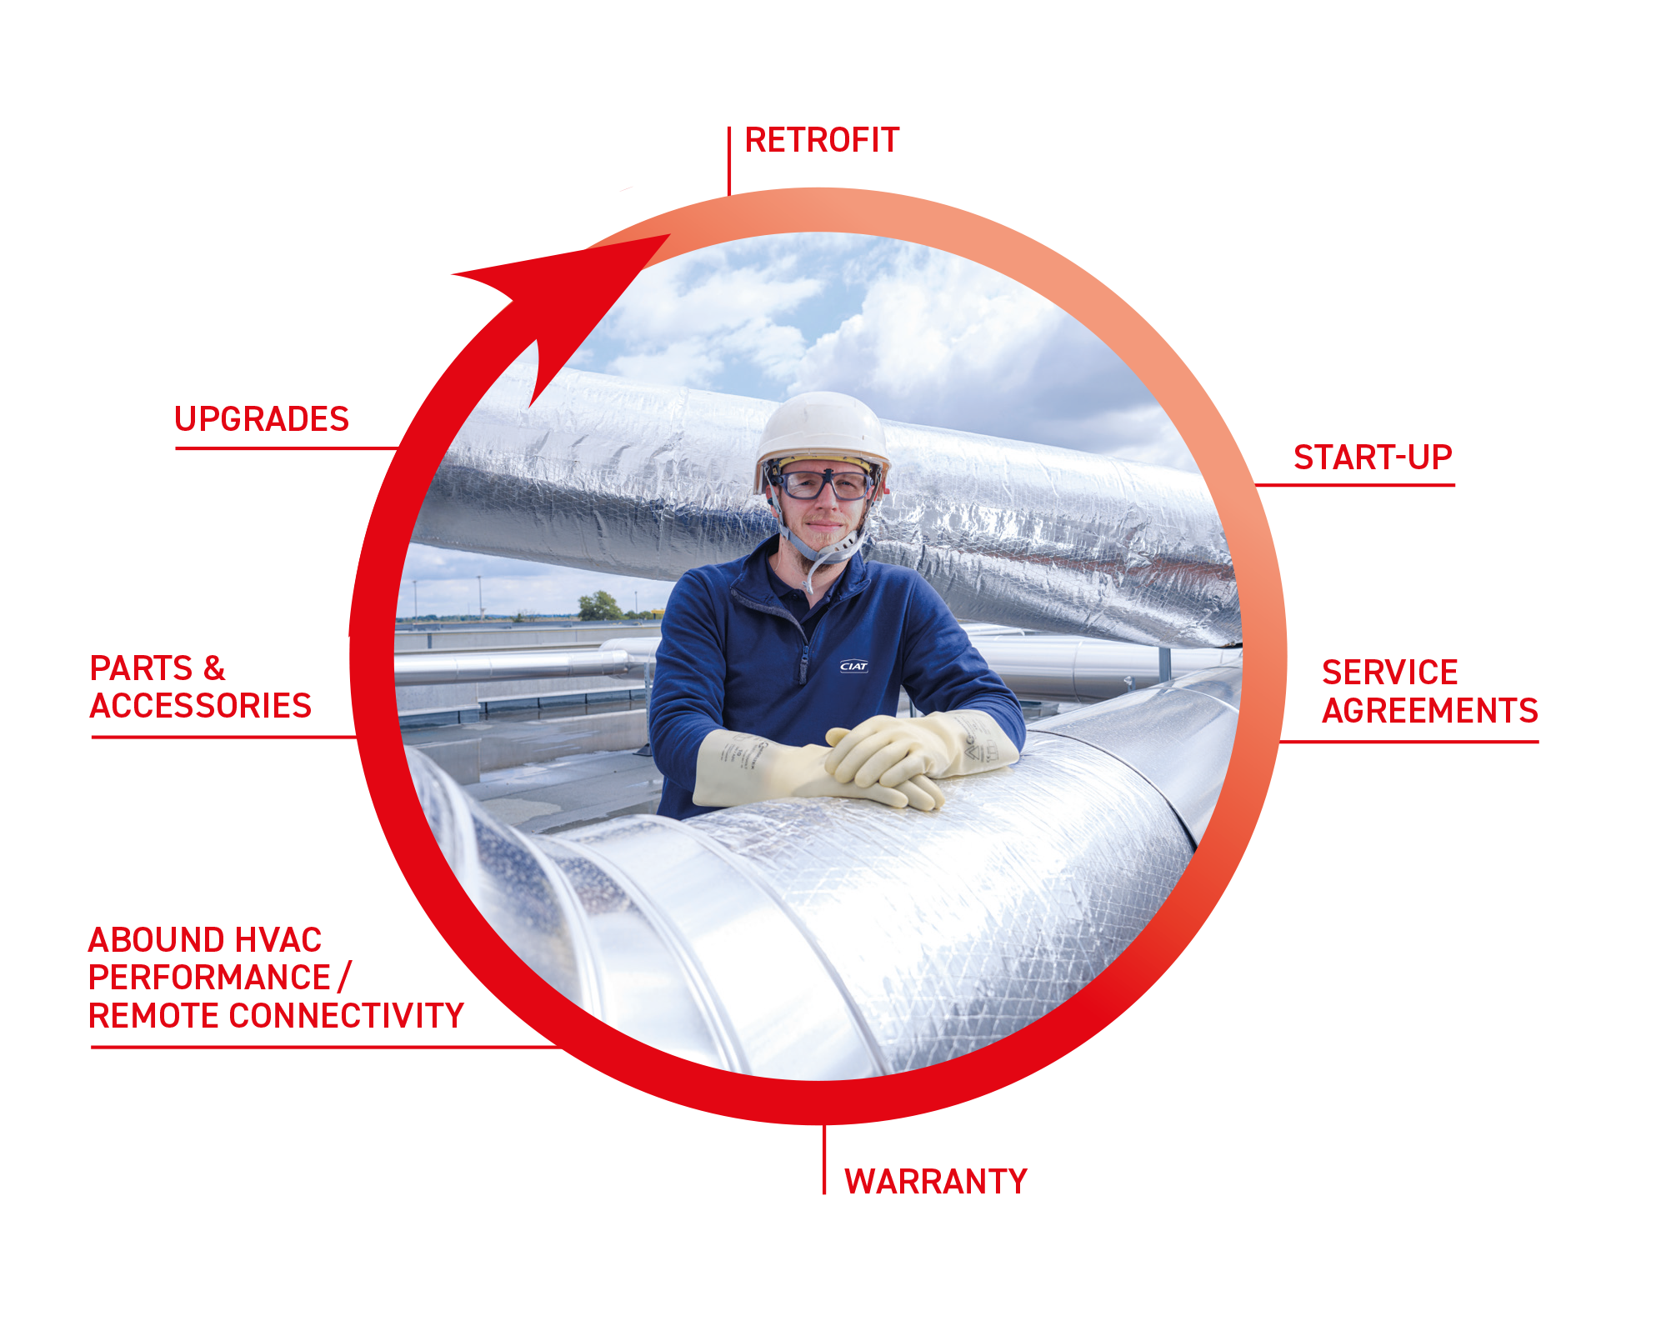

A WHOLE WORD OF SERVICES
A COMPLETE SERVICE OFFER
Our full spectrum service and maintenance offering gives total peace of mind for building owners and managers. Organisations both large and small trust us to look after their buildings and HVAC needs, ensuring reliable, efficient, cost-effective buildings that are comfortable to live and work in.
We have a choice of service levels, enabling you to tailor the level of cover exactly to your needs and budget.
We have a range of intelligent remote monitoring solutions, providing 24/7 alerts for potential problems. Our expert analysts constantly review any out of condition or alarm statuses, to diagnose issues and prioritize service calls to reduce costs and restore full operation in the shortest possible time.

Slide 46



A TIER FOR EVERY BUSINESS
From preventative to full coverage, our CORE, ENHANCE, ELITE tiers are designed to fit your needs.
Complete preventive maintenance and technical expertise including proactive monitoring on health, efficiency and performance with actionable insights to identify opportunities for reducing operating costs and avoiding failures.
Our Elite plan is the ultimate worry-free, peace-of-mind program for clients. Realizing building comfort, efficiency and operational goals with Carrier turn-key solutions powered by predictive analytics and OEM expertise.
An economical solution for customers with loT-enabled equipment that collects real-time data to improve staff efficiency and reduce unplanned downtime.

Slide 47
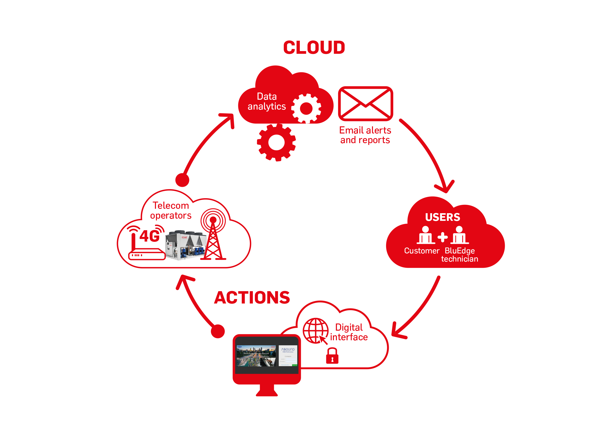


Real-time data and Analytics
Our portfolio of remote connectivity offers within BluEdge service Platform are powered by IoT and cloud analytics. It ​is an advanced monitoring solution which enables customers for all applications to track and monitor their CIAT equipment.
24/7 remote monitoring.
Proactivity to anticipate breakdowns.
Real time data
Monthly and annual reports with analysis and recommandations from BluEdge CIATexperts.
Email alert for any event concerning the equipment.

Slide 48

EUROPEAN SERVICE DIGITAL CENTER
Expert in Digital, IoT & Connected Services Solutions
for HVAC equipment and in Controls Solutions for
Plant Room and HVAC Systems.
At the European Service Digital Center (ESDC), our engineers focus on developing and deploying Connected Services and Controls solutions for HVAC equipment & systems. They provide technical support on smart service solutions to our customers and our service organizations in Europe. The team has a unique multi-disciplinary expertise in Digital/IoT/Controls and Cooling/Heating for HVAC systems.
CONTROLS AND ENERGY OPTIMIZATION
Monitoring of HVAC equipment
Plant Room control system
Thermal Energy Storage for HVAC applications
HVAC system management
Energy Optimization

Slide 49
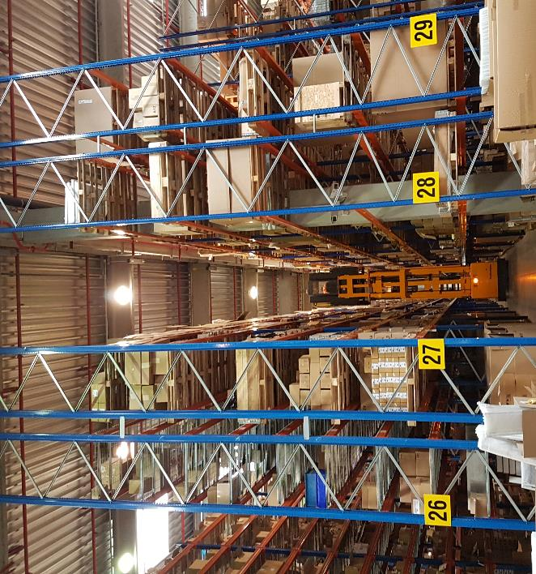
HVAC EUROPE PARTS CENTER
DEDICATED TEAM & EXPERT ADVICES
500 Suppliers
12,000 Items on stock
176,000 Order lines in 2019
1,000,000+ Parts sold in 2019
Store-eu.carrier.com
98% Deliveries on time
+90.000 Managed parts number

Slide 50
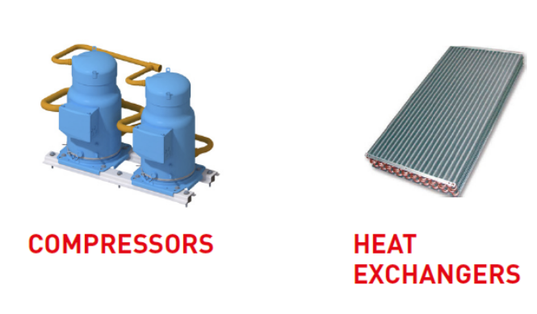

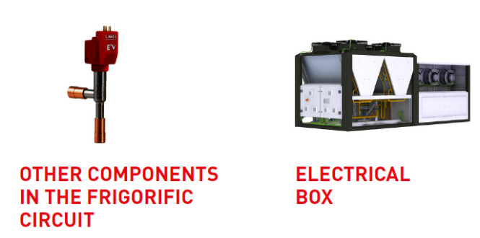

CIAT SERVICE SOLUTION
Retrofit kit
The retrofit kit for the VECTIOS POWER range is available from 100 kW to 280 kW.
This kit makes it easy to retrofit a VECTIOS POWER R-410A unit to be compatible with R-454B refrigerant with only minor adaptations. This
results in 80% savings on taxes when refilling is required.
Conformity declaration
VECTIOS POWER range was designed to be compatible with this retrofit modification. The modifications must be completed as specified by the applicable instruction manual. This modification of the machine must be indicated in the maintenance book of the machine in compliance with local regulations. Also, a plate needs to be added with information about the new refrigerant R-454B.

Slide 51
Thank you for your attention

Slide 52
A CARRIER COMPANY
The materials and information referenced in this presentation are for informational purposes only and not for the purpose of providing legal or other professional advice.
©2023 Carrier. All Rights Reserved. CIAT reserves the right to change certain information and specifications contained in this document at any time and without prior notice.
Availability depends on each country. Please contact your CIAT representative.
Aquaciat & Aquaciat^{power} – English – 2023
Photos: CIAT, istock

